Slide 1


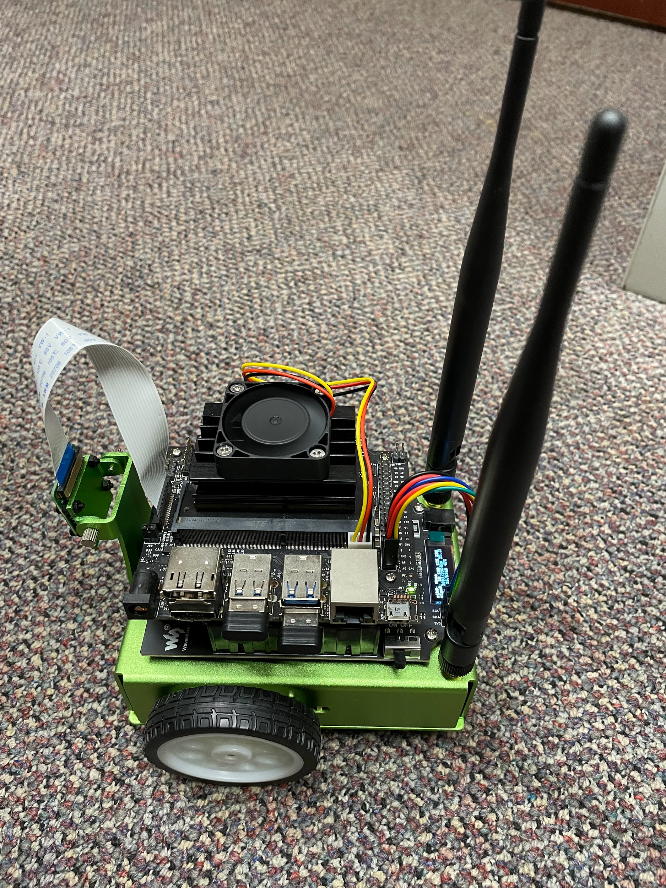
Autonomous JetBot Project
Kwai Wong, Patrick Lau, Franklin Zhang, Eric Zhao
University of Tennessee, Knoxville
2022 - 2023

Slide 2
Contents
Goals and Purpose
Modeling Specification (demo)
Hardware Specification (kit)
Hardware/Software Schematic
Software Specification
Process
Setup
Data Collection
CVAT
Data Organization
Training
Testing
Running the robot
Updates – Improved Turning (with robot point of view)
Updates – Collision Avoidance (demo)

Slide 3
What : Goals of the Project
Run a JetBot vehicle autonomously using a Jetson Nano GPU Card
Why : Purpose of the Project
Setup a practical application for a class project
Showcase the ability of the DNN functionalities
Integrate a set of software tools from Nvidia onto the Jetson Nano Card

Slide 4
Modeling Specification of the Project
Run a toy vehicle autonomously on a cross section of pathway
The robot should be able to:
Follow the straight parts of the road
Respond to U-Turn signs placed at each of the four ends by turning around
Respond to Turn Left/Turn Right signs placed at the intersection by turning accordingly
Signs are different colors on a white background:
U-Turn = red, Left Turn = green, Right Turn = yellow

Slide 5
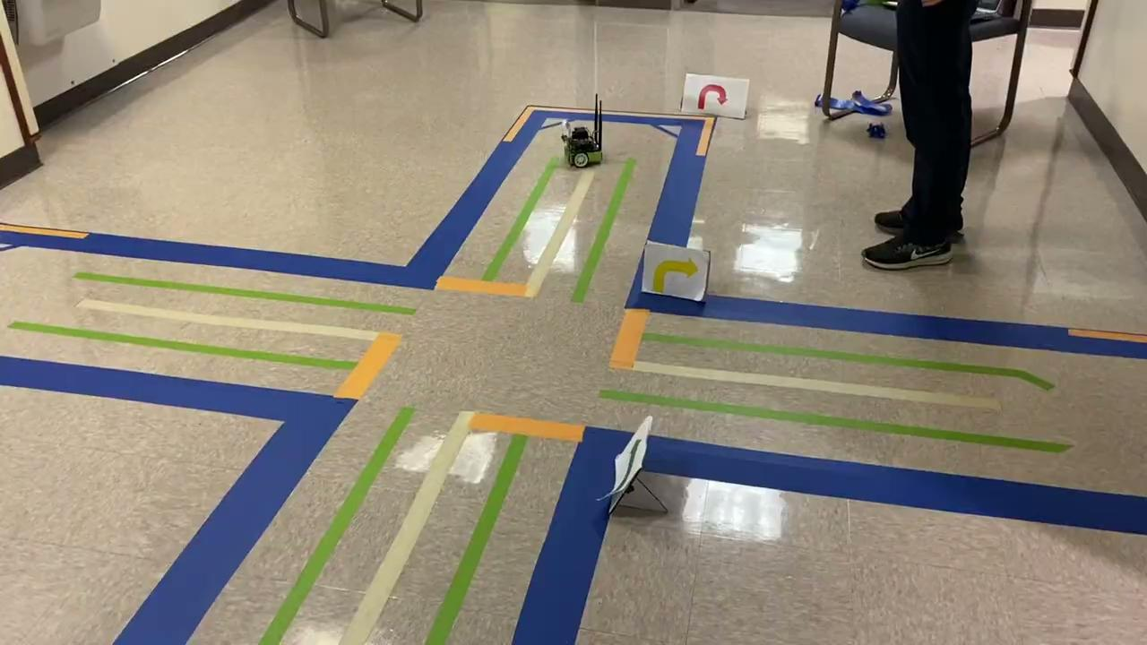
Demonstration Video

Slide 6
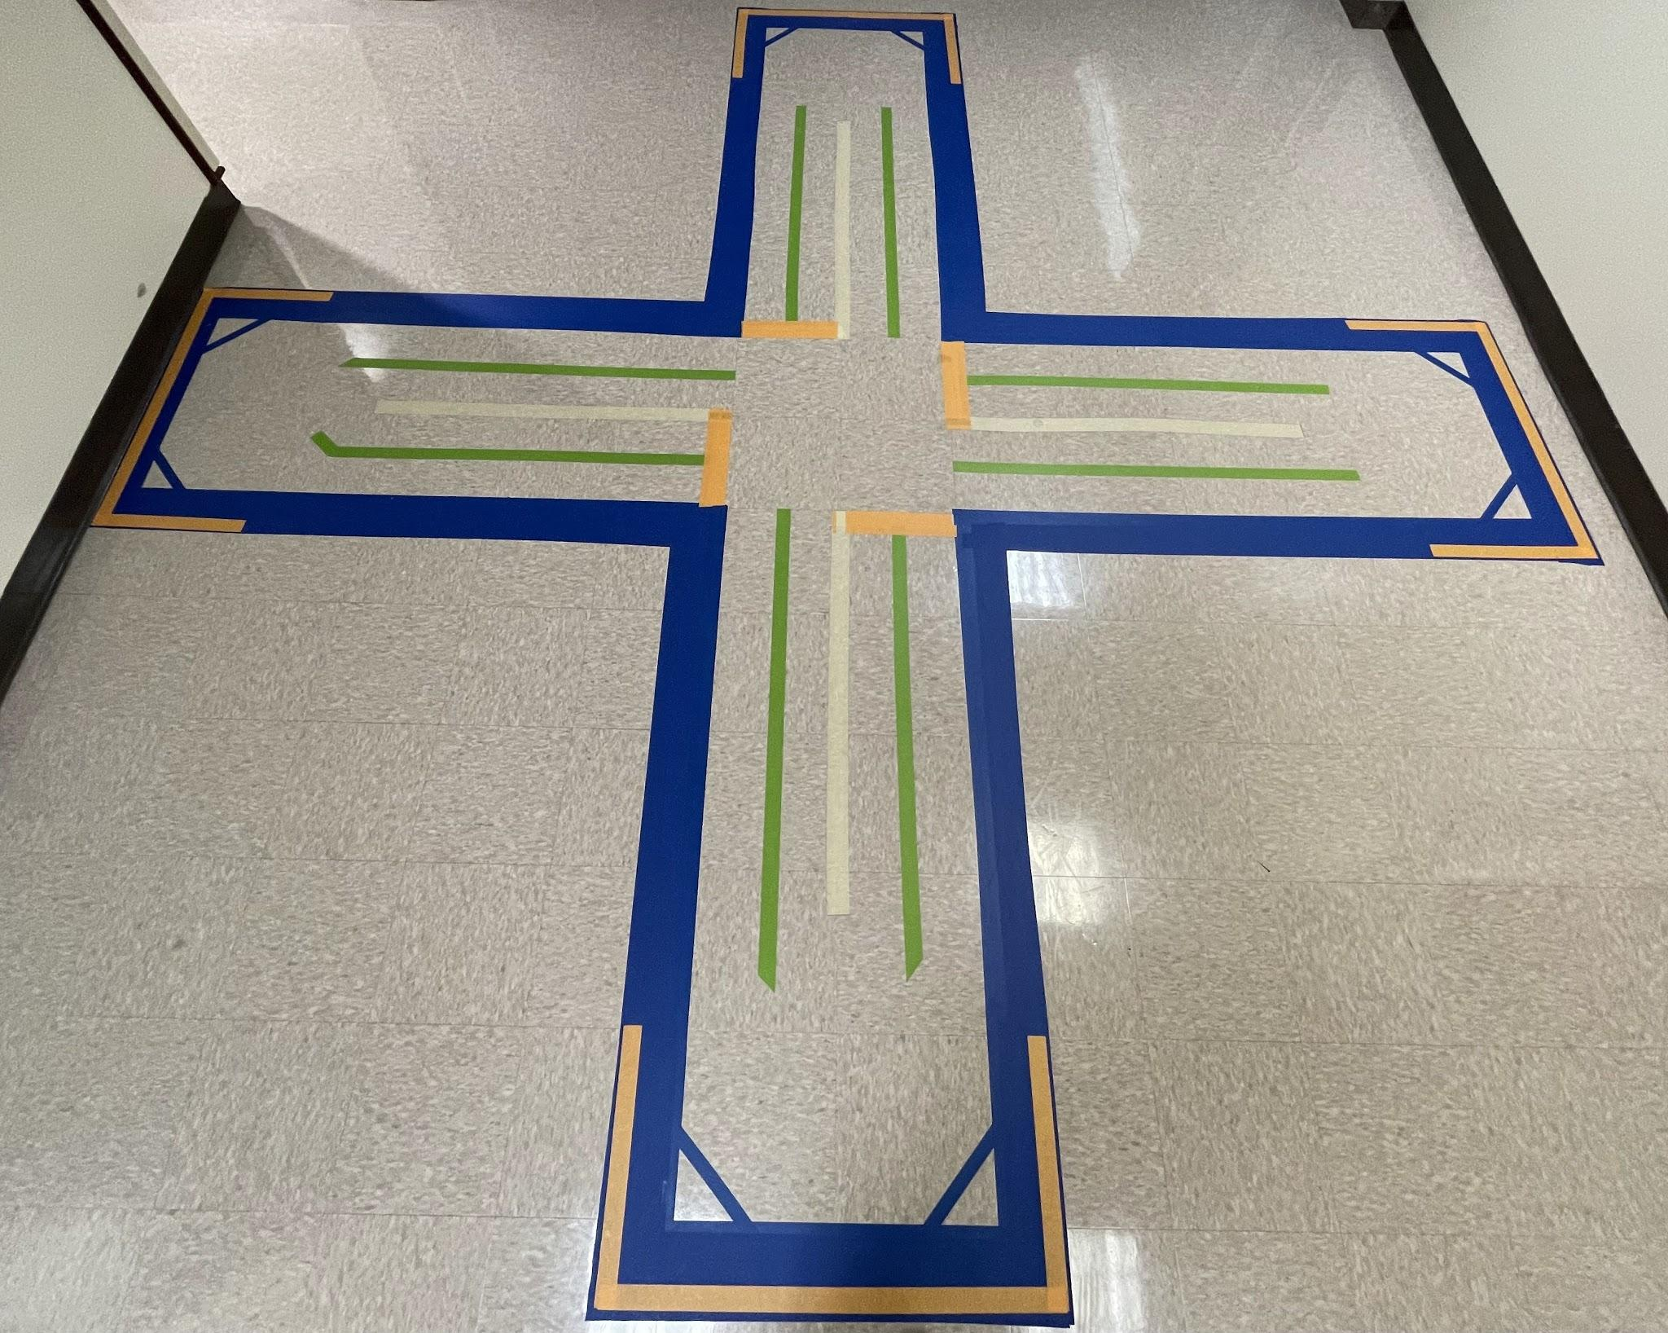
Course
23 in
23 in
10 in
The green tape is all that’s needed for this specific project, but there’s certainly room to experiment with other tape. (Some additional work with the orange tape was done later.)
All measurements are precise to half an inch, but the measurements don’t need to exactly match.
The green tape is 1.5 in wide.
45 in
5 in
4.5 in
16 in
5.5 in

Slide 7
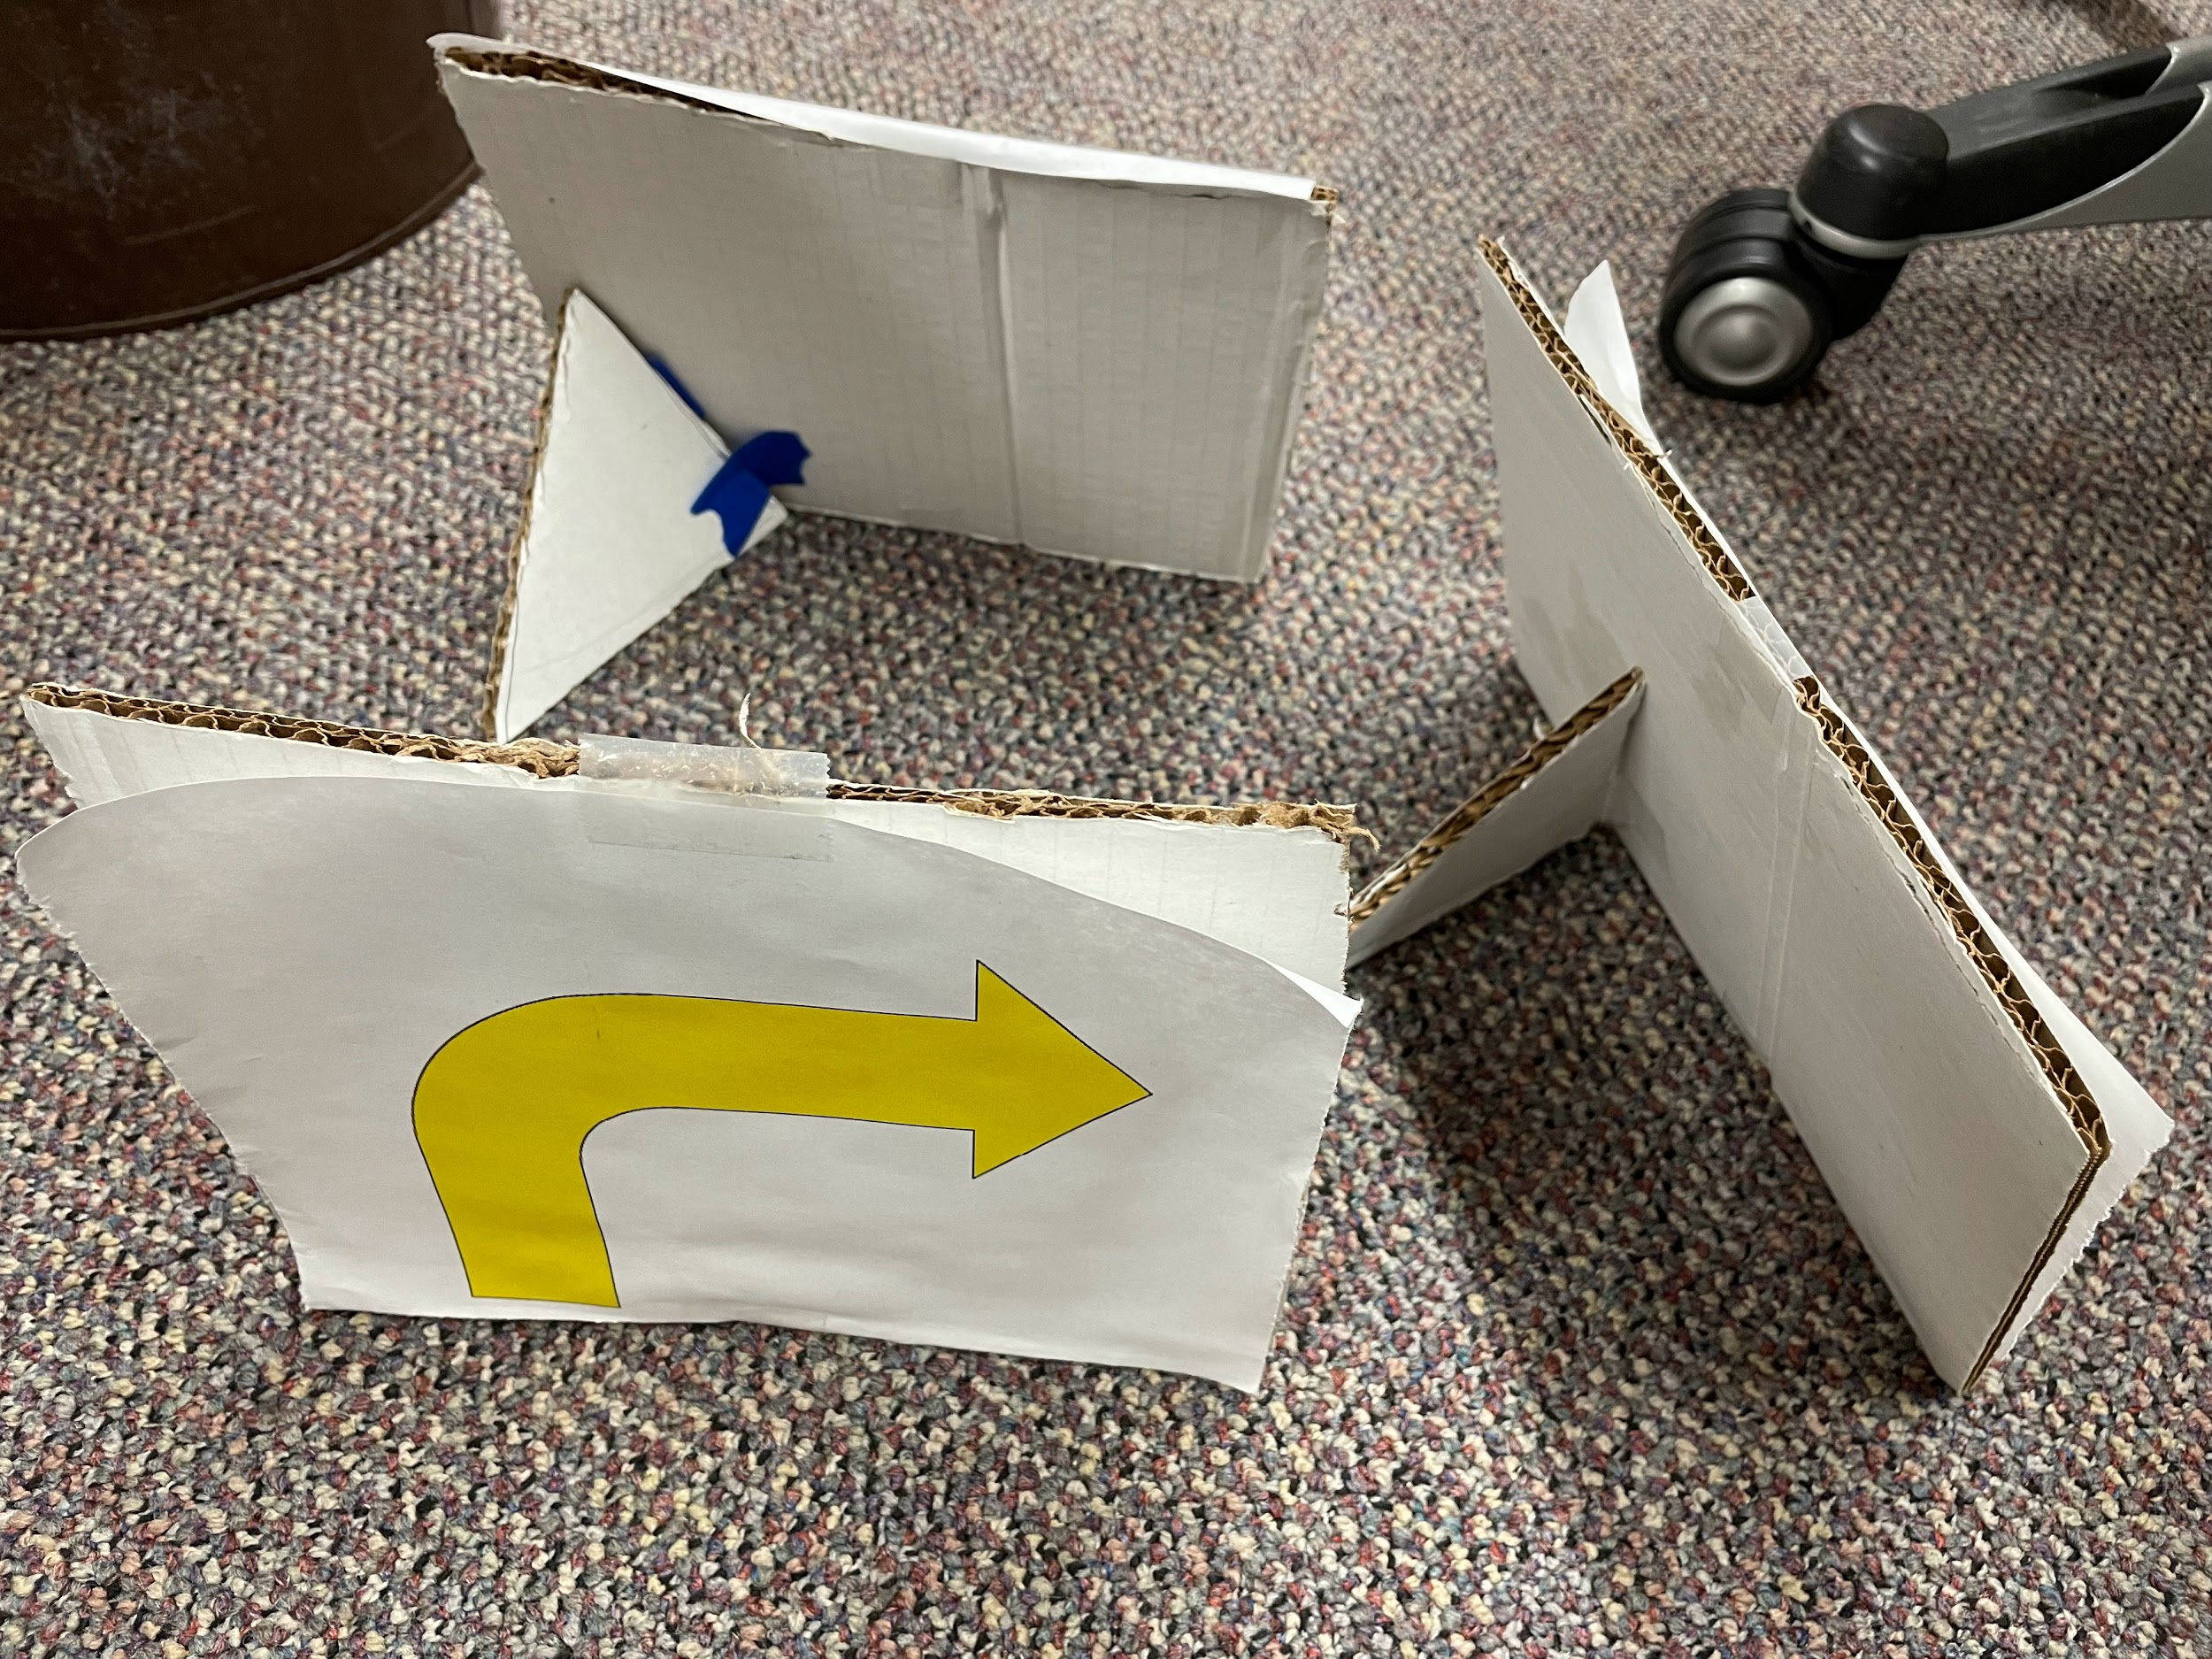
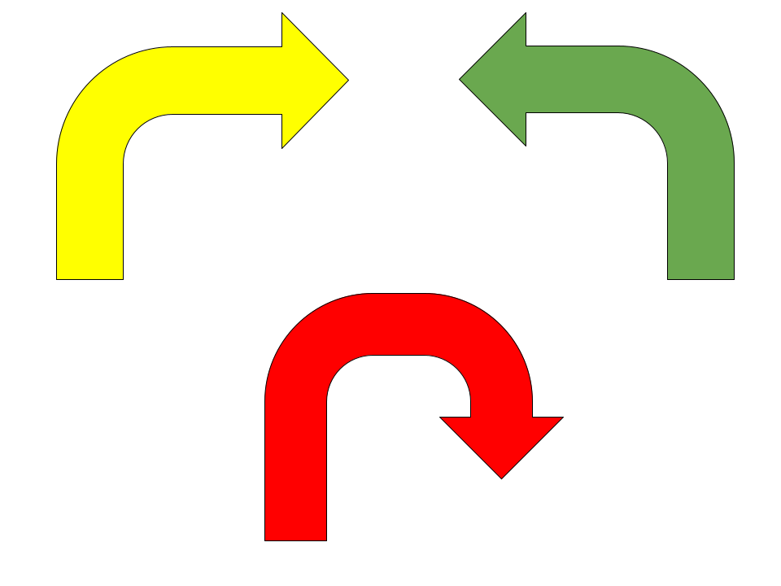
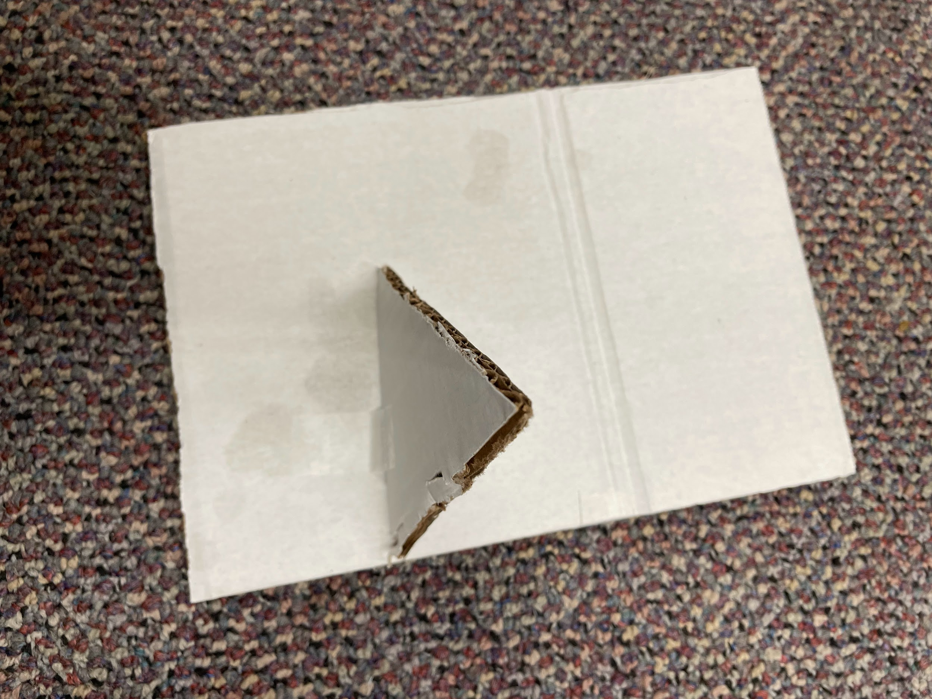
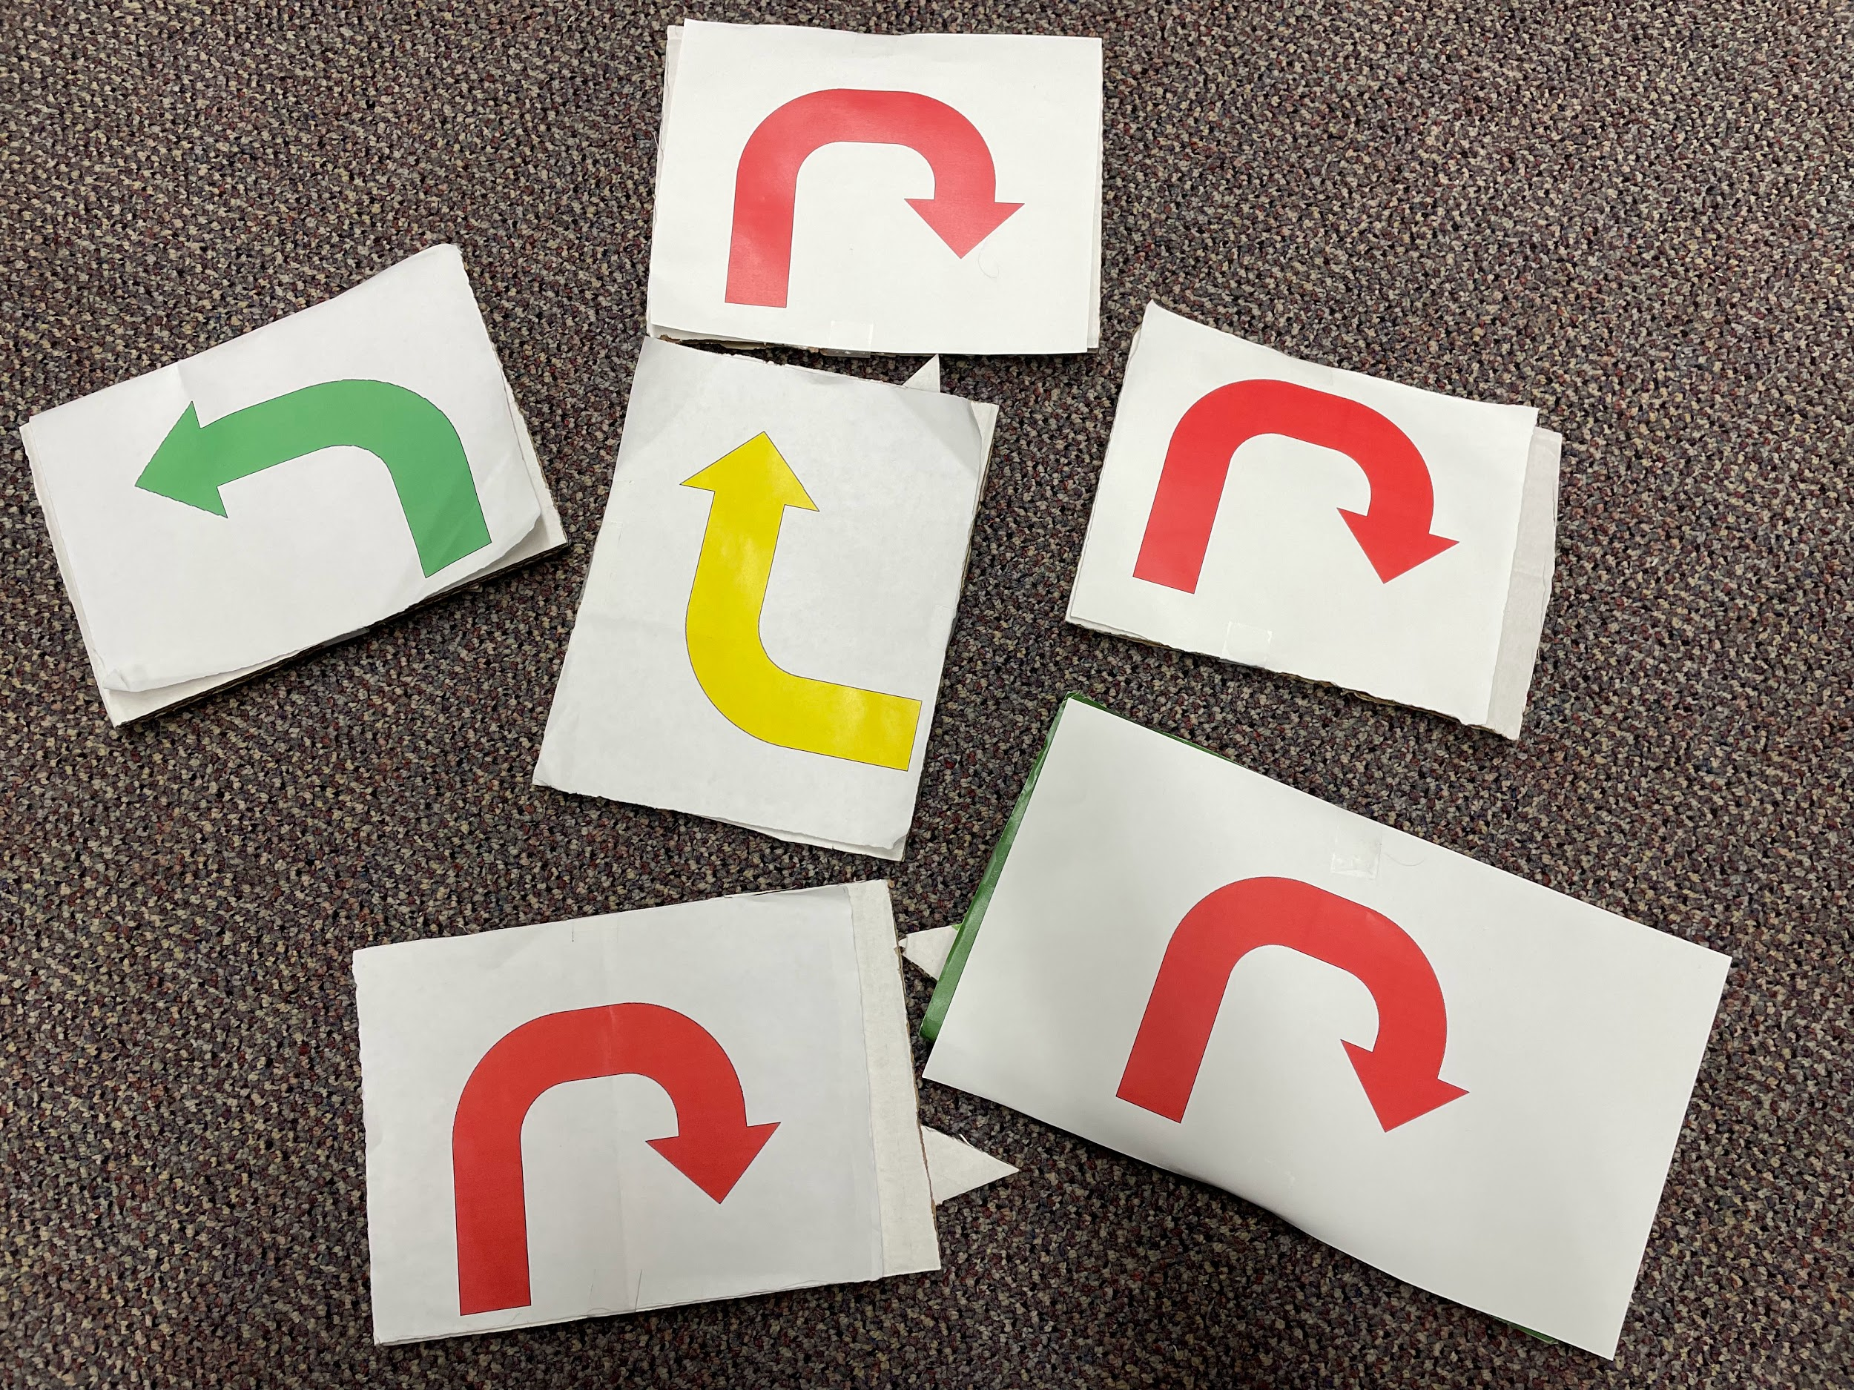
Signs
Drawing
Printable
https://docs.google.com/document/d/1zxXWrhZquiRAq2lARWC_oSfjJx4mTcNcrNoBi8vthRA/edit?usp=sharing
Back view
The signs tend to be about 6 in by 8 in, though there is no need to be exact.

Slide 8
Hardware Specification of the Project
Toy vehicle
WiFi Antennas
Camera
Wheels, motors
Jetson Nano GPU Card
(a computer)
JetBot Expansion Board
Batteries
Gamepad controller / dongle (for movement and image capture)
Separate laptop/computer – used to remotely access and control the robot

Slide 9
Hardware Specification of the Project
Kit (image on next slide): https://www.waveshare.com/catalog/product/view/id/3755 or https://www.amazon.com/Waveshare-JetBot-AI-Kit-Accessories/dp/B07V8JL4TF/?th=1
Info: https://www.waveshare.com/wiki/JetBot_AI_Kit
Batteries must be purchased separately. See the batteries slide (a few slides later) for more info. A laptop or other computer is also needed.
Ignoring the laptop, estimated total cost is around $400.
Useful Links
https://www.waveshare.com/wiki/JetBot_AI_Kit_Assemble_Manual
– Hardware assembly guide (not needed if robot already set up)
Note: images of assembly of a slightly different JetBot can be found in the jetbot/docs/images directory that is located on all JetBots or linked here: https://github.com/NVIDIA-AI-IOT/jetbot/tree/master/docs/images

Slide 10
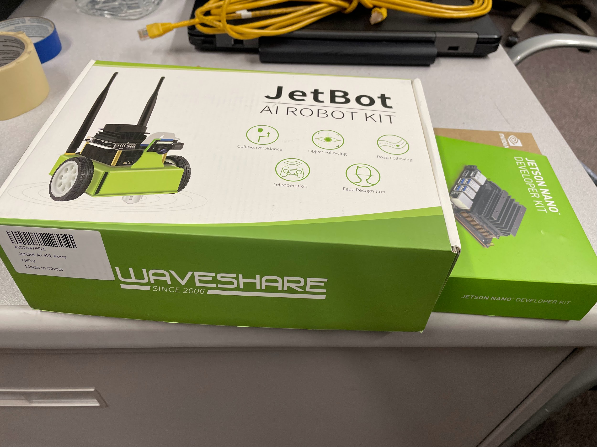

Slide 11
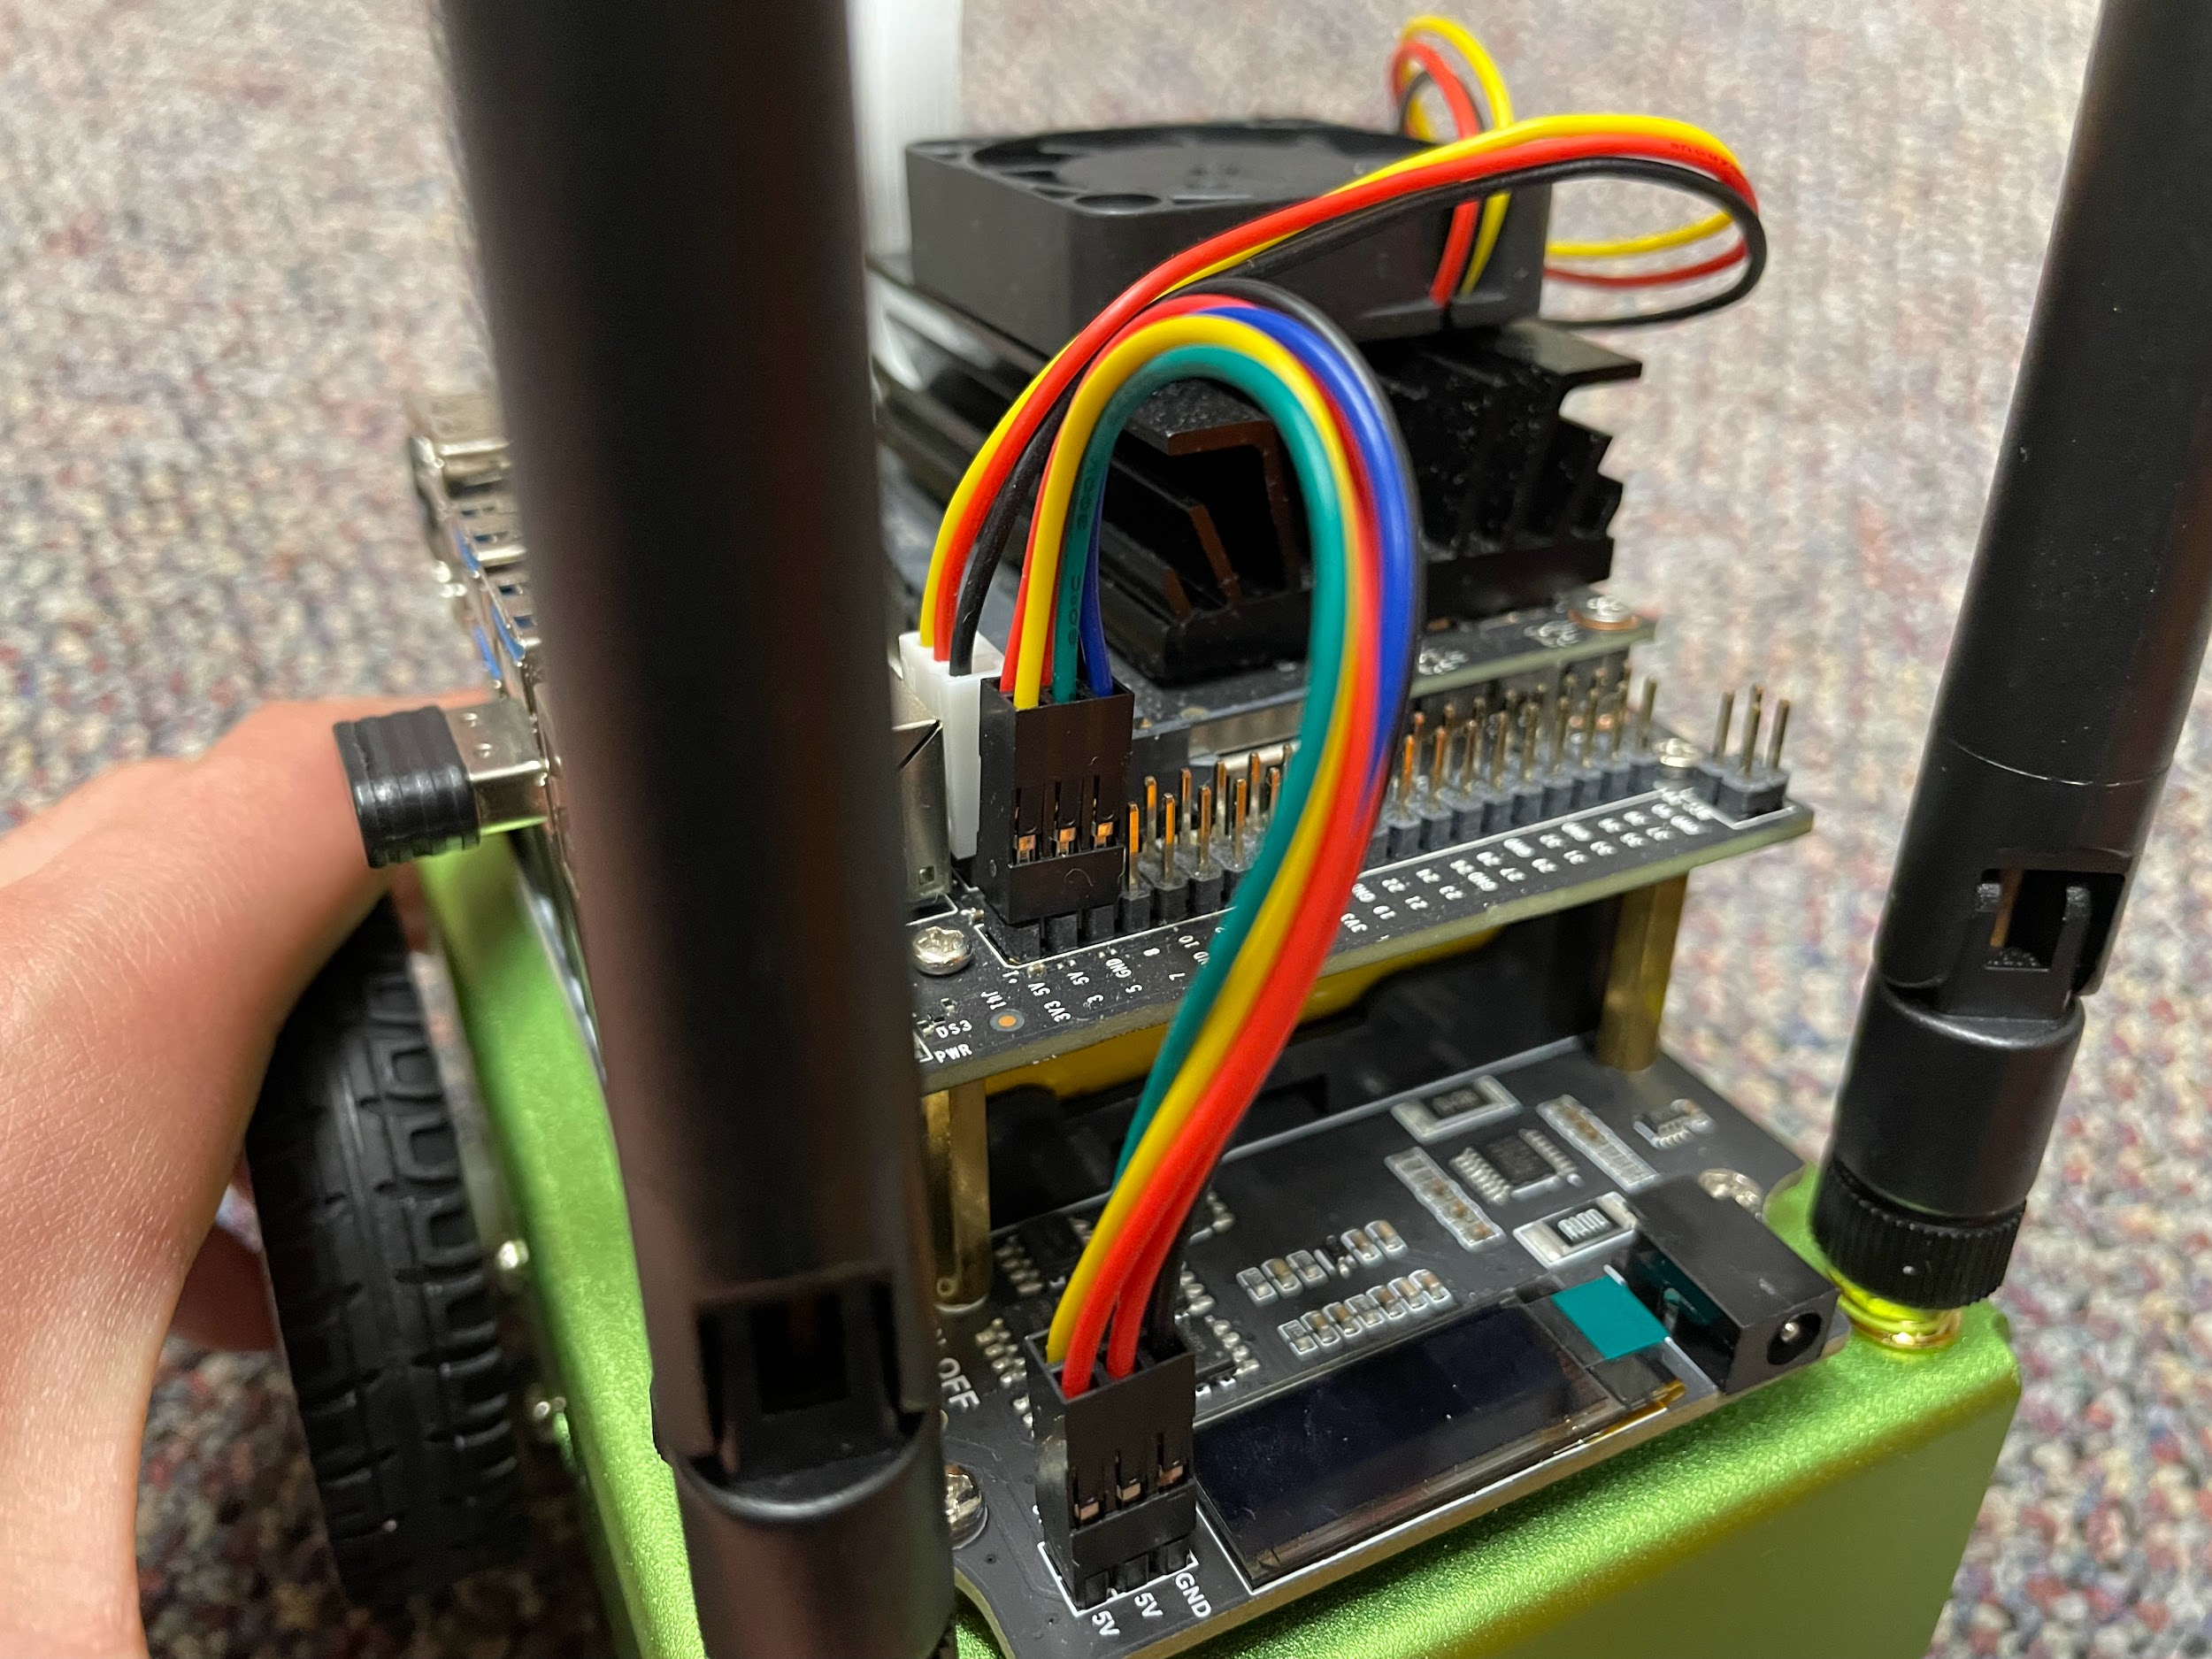
Wiring, Antennas, Charging (back view)
Cooling Fan
Fan Connection
Heat Sink
WiFi Antenna
WiFi Antenna
Jetson Nano GPU
JetBot Expansion Board
Communication and Power Wire
Screen
Charging Port
(for batteries)
The fan cools the heat sink, which assists cooling as it absorbs heat from the Jetson Nano and has a greater area of contact with the cool air. The communication and power wire supplies power to the Jetson Nano from the batteries and allows it to communicate with the JetBot Expansion Board and motors.

Slide 12
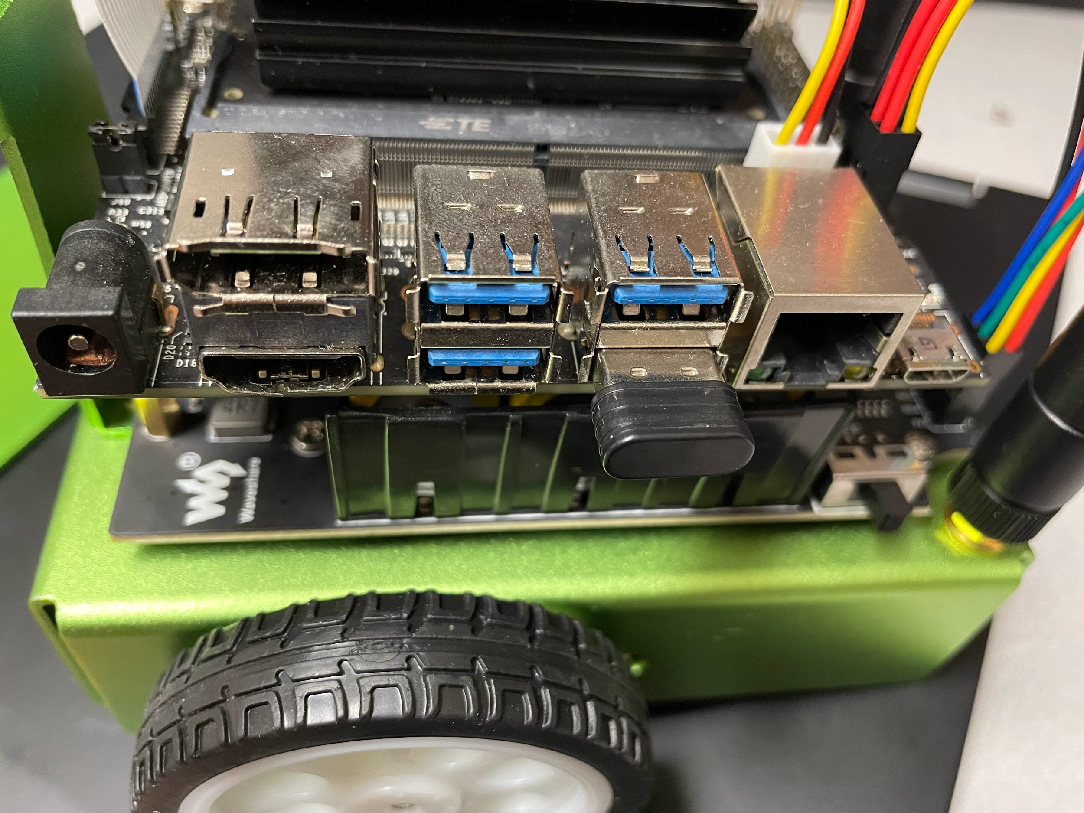
All labeled parts here except the power switch are part of the Jetson Nano.
Ports and Power (left side view)
This jumper controls which charging port is usable. Putting it on will allow one charging port to work, while removing it will disable that one and enable the other.
Charging Port
HDMI Port
Charging Port
DisplayPort
Batteries
USB Ports
Controller Dongle
Power switch
Neither of these charging ports actually charge the battery; they just provide a temporary power supply.
Non-charging ports can connect the Jetson Nano to a monitor, mouse, keyboard, etc.

Slide 13
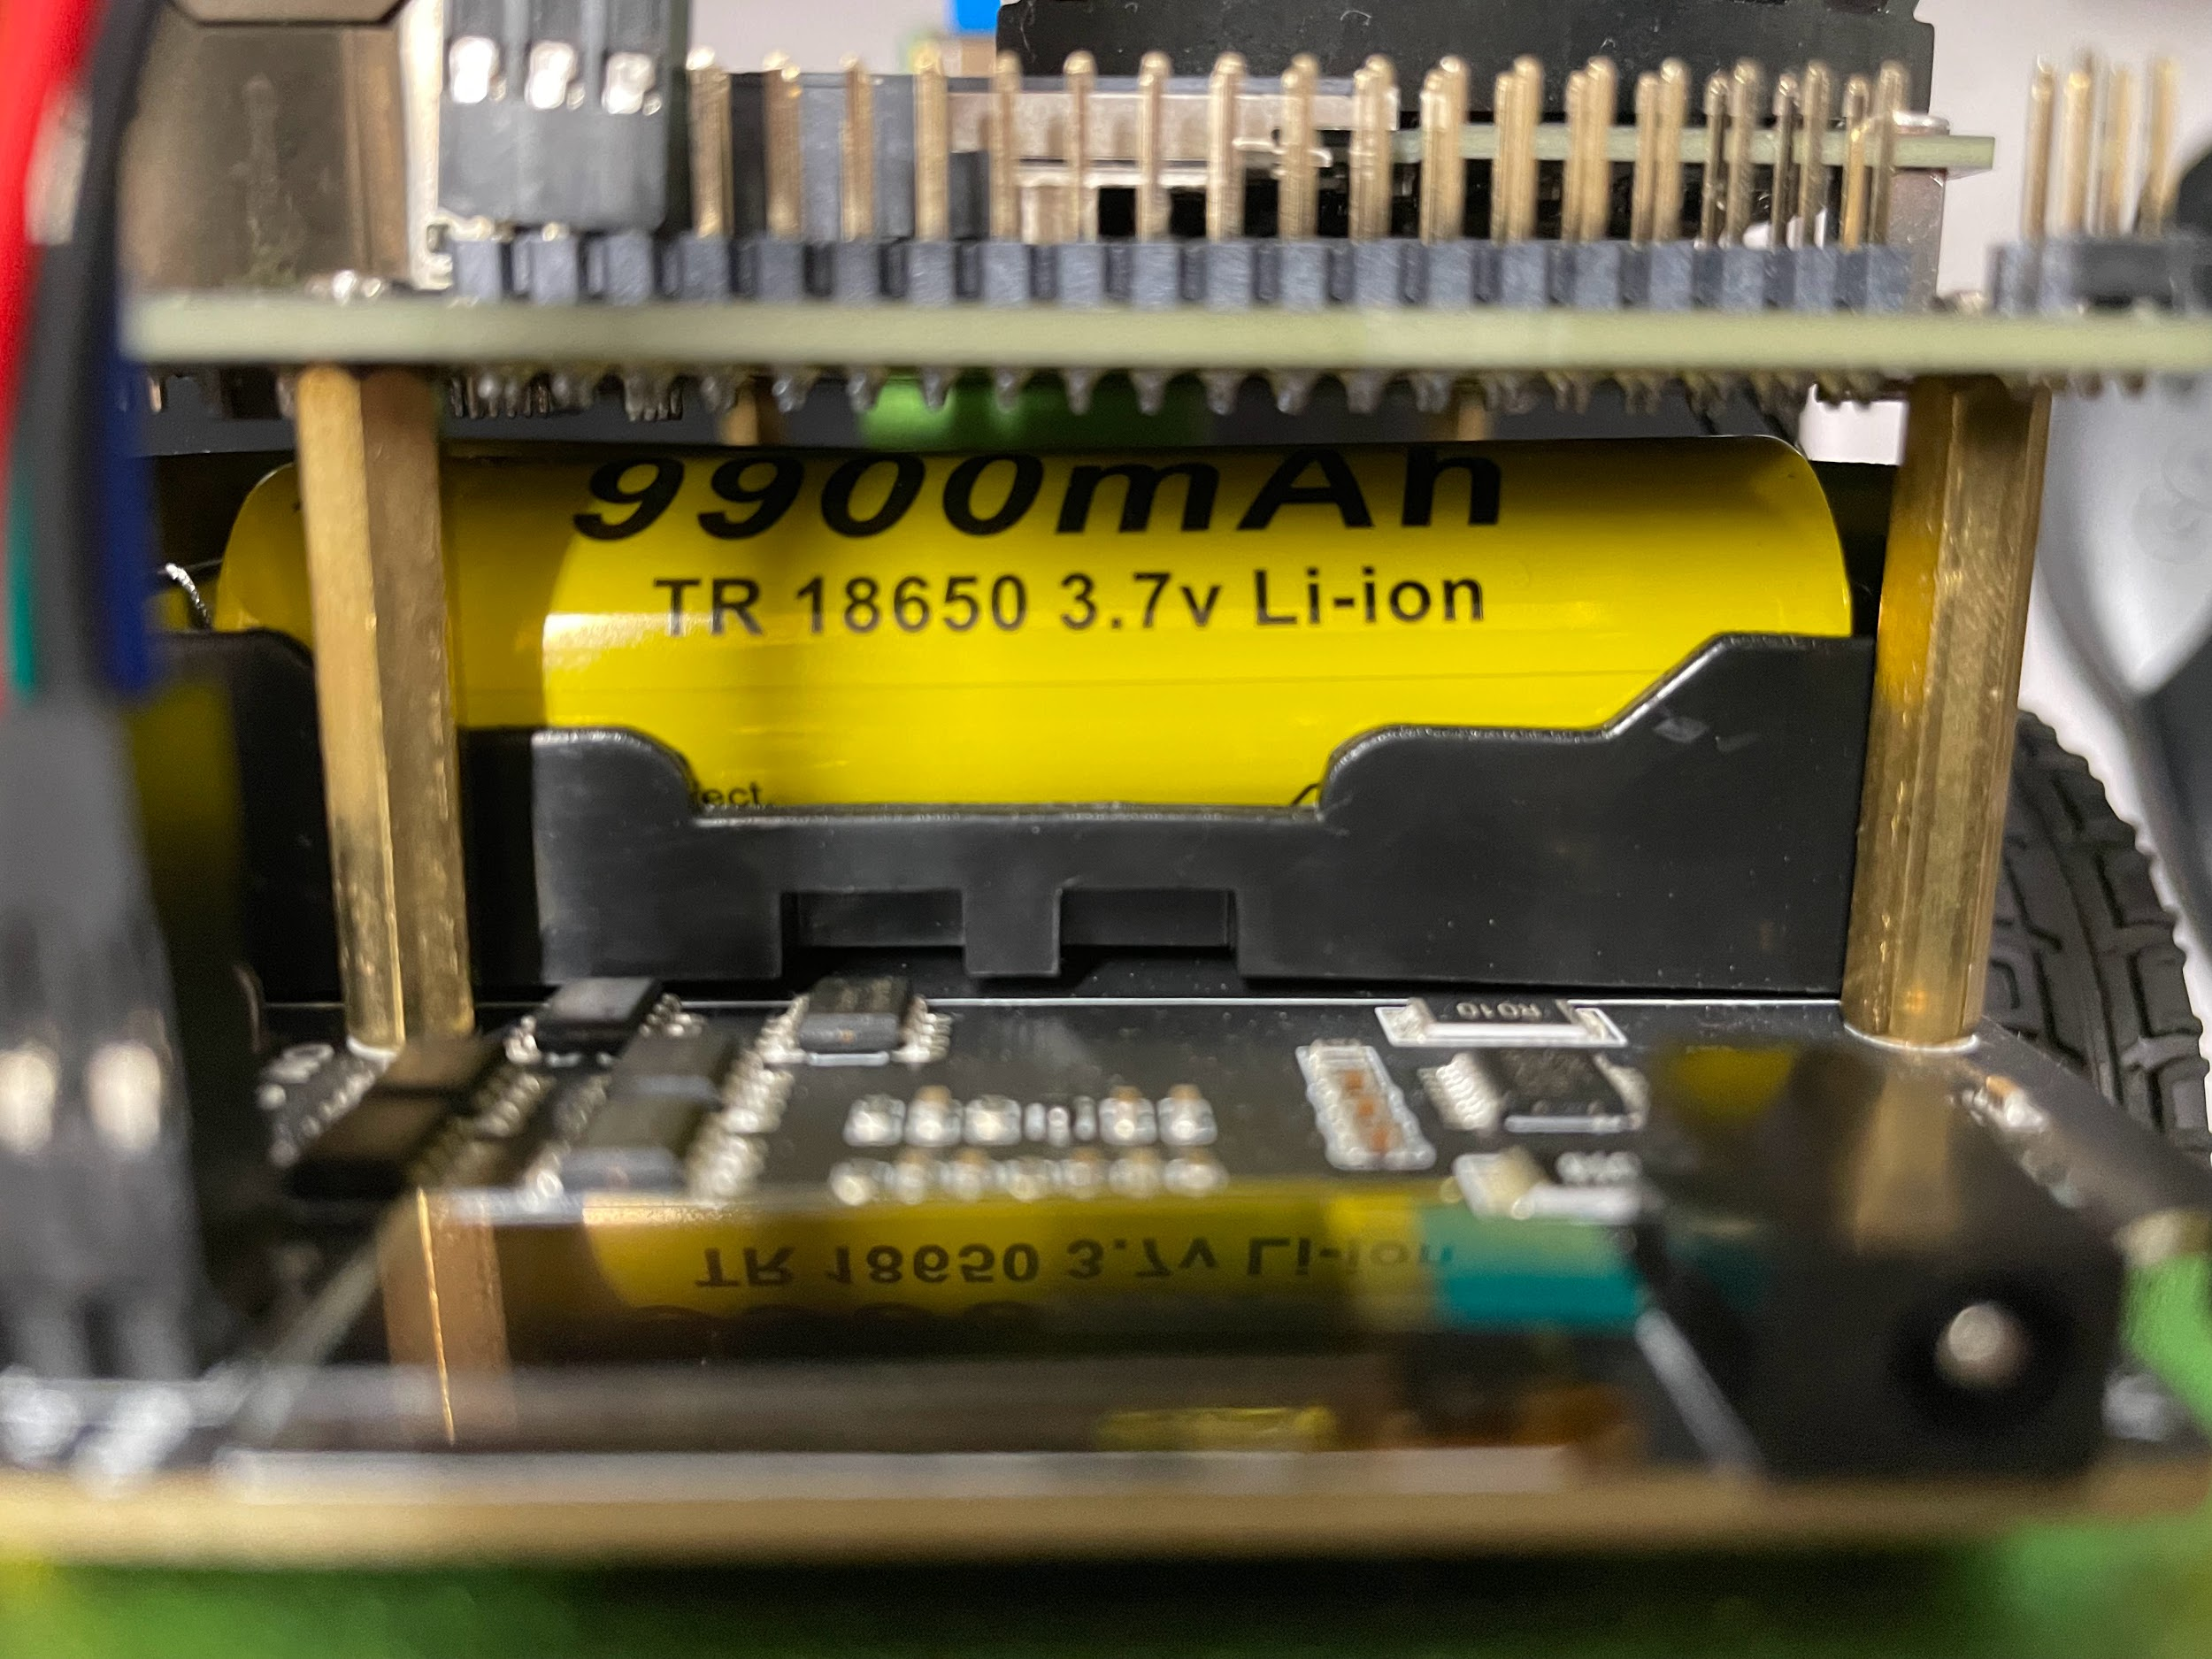
Batteries (back view)
There are three TR 18650 3.7v Lithium ion batteries (9900 mAh).
The batteries can only be charged via the charging port on the bottom right here (more clearly shown two slides ago).

Slide 14
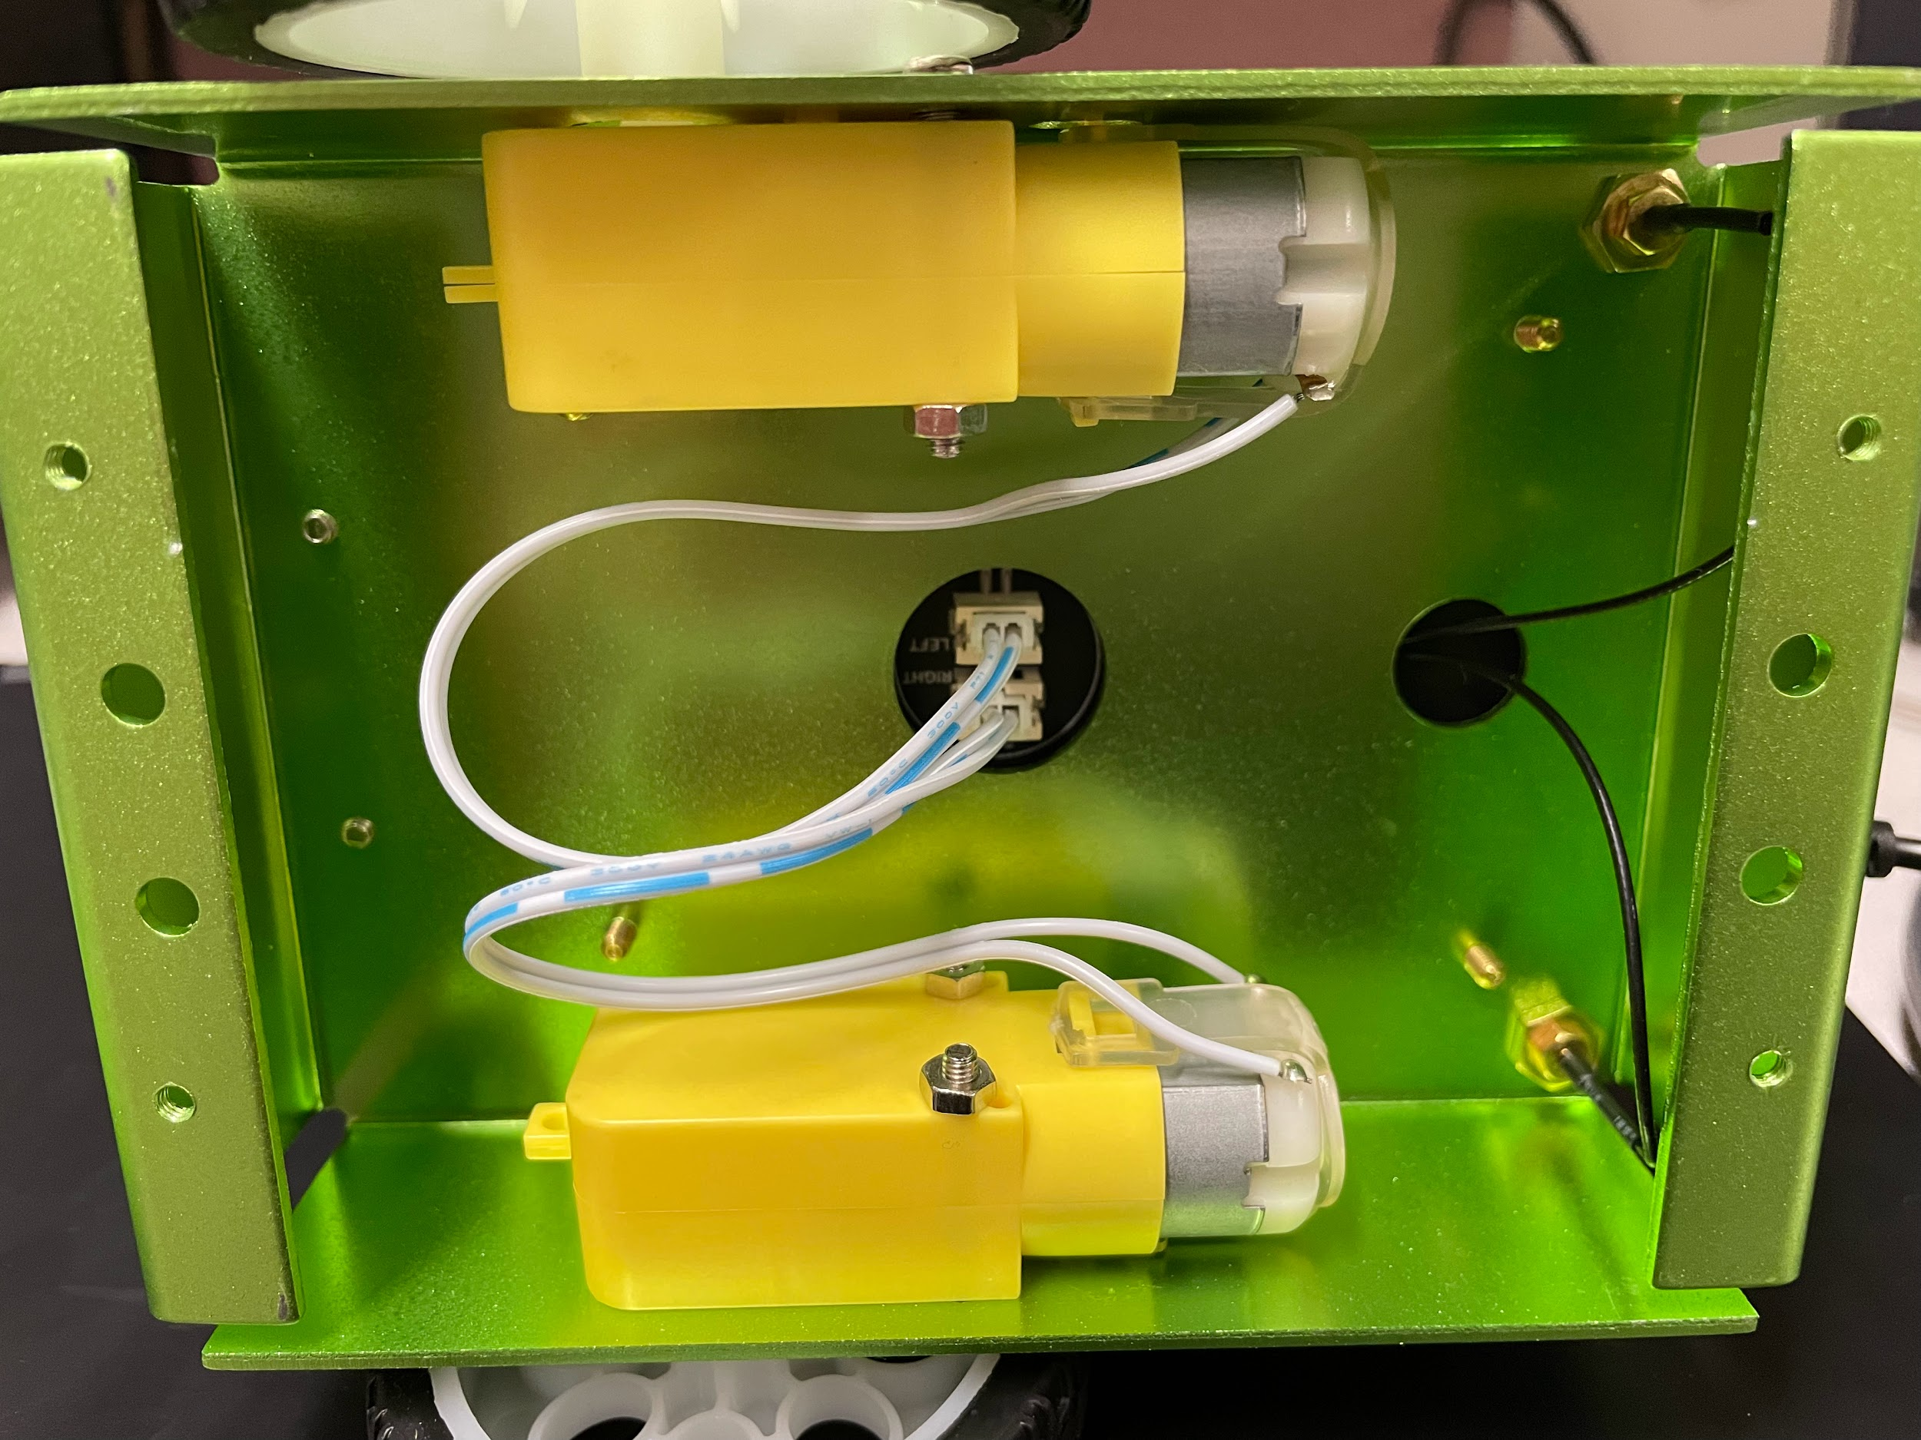
Motors (bottom view, cover unscrewed)
Motors
Motor connections to expansion board
WiFi antenna connections to Jetson Nano
Two independent motors inside the bottom of the robot control the wheels.
Turning occurs when one motor spins faster than the other.

Slide 15
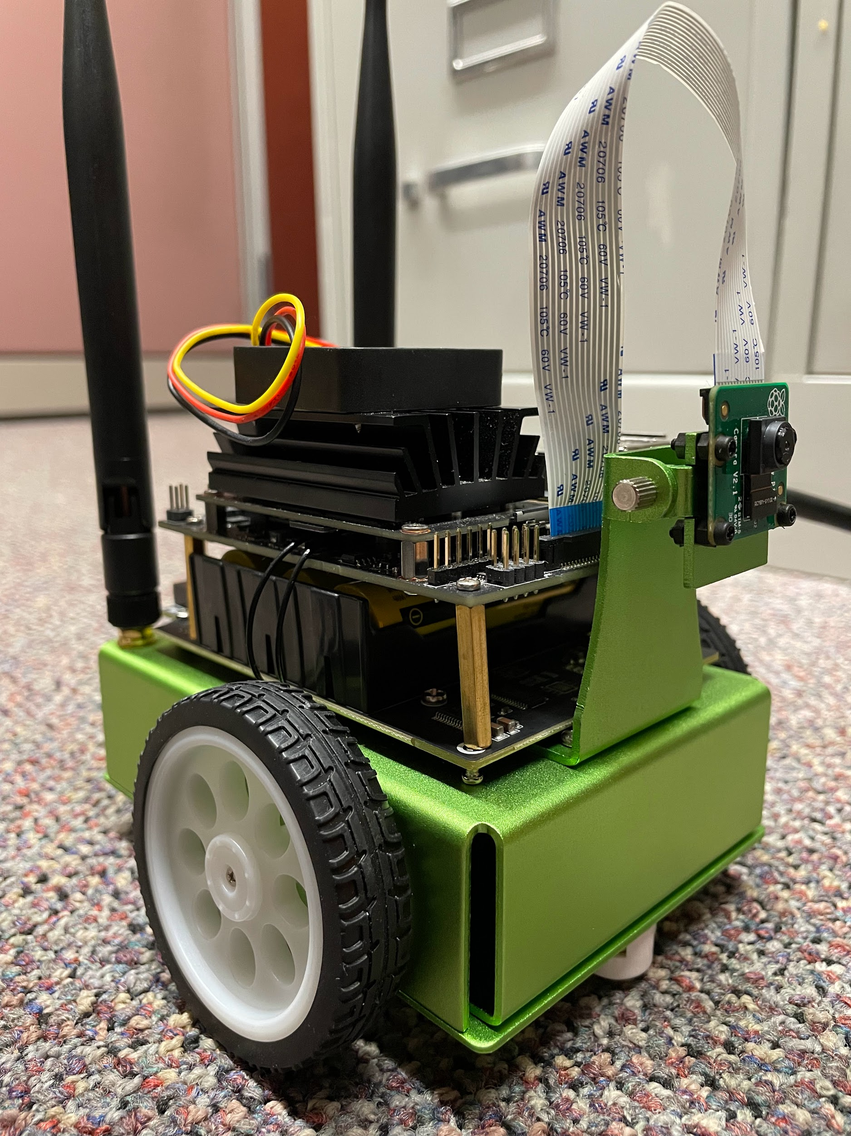
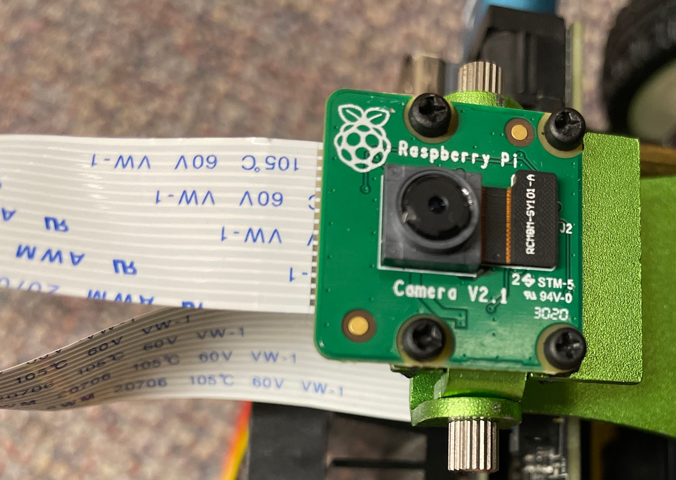
Front/Right View
Camera connection wire to Jetson Nano
Camera
MicroSD Card
Camera Closeup: (https://www.waveshare.com/product/rpi-camera-v2.htm)

Slide 16
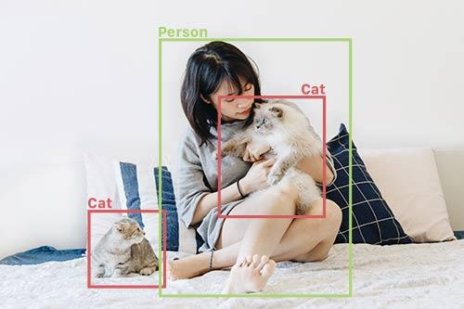
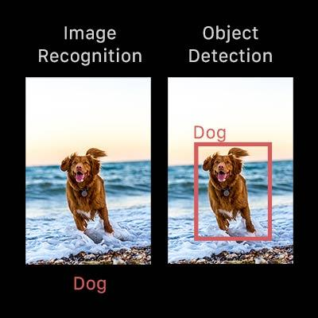
Object Detection
This project uses object detection. This type of neural network can recognize not only what objects are in the image, but their location and size (represented by bounding boxes).
Also, this project uses transfer learning to train a neural network – taking a pretrained model and retraining it on new data.
The pretrained model is SSD-mobilenet-v1, trained on 91 classes.
https://github.com/dusty-nv/jetson-inference/blob/master/docs/detectnet-console-2.md

Slide 17
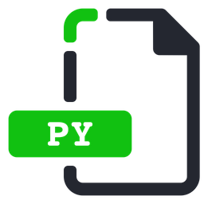
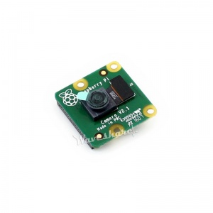

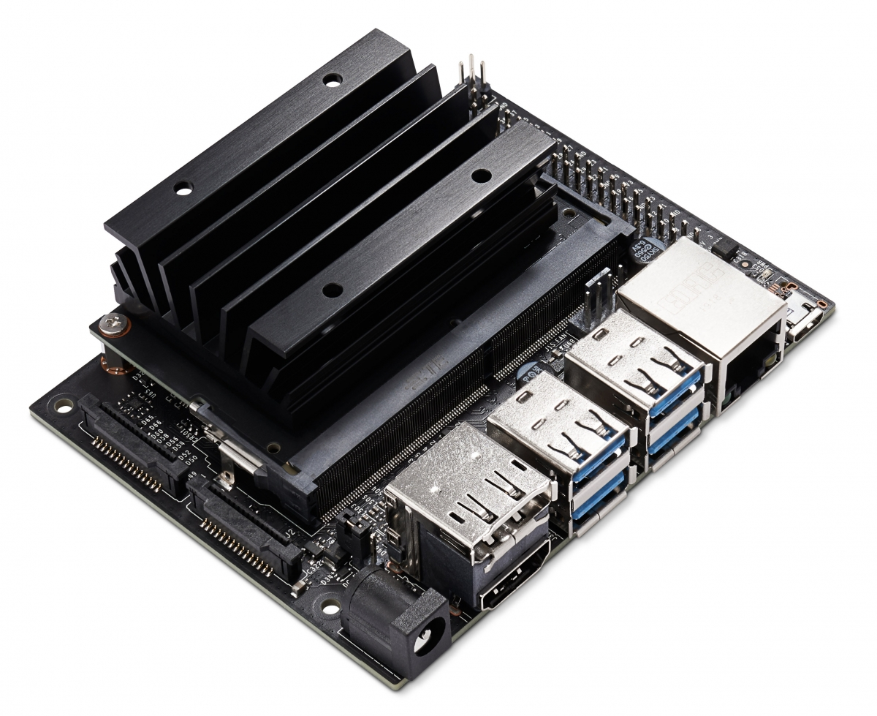
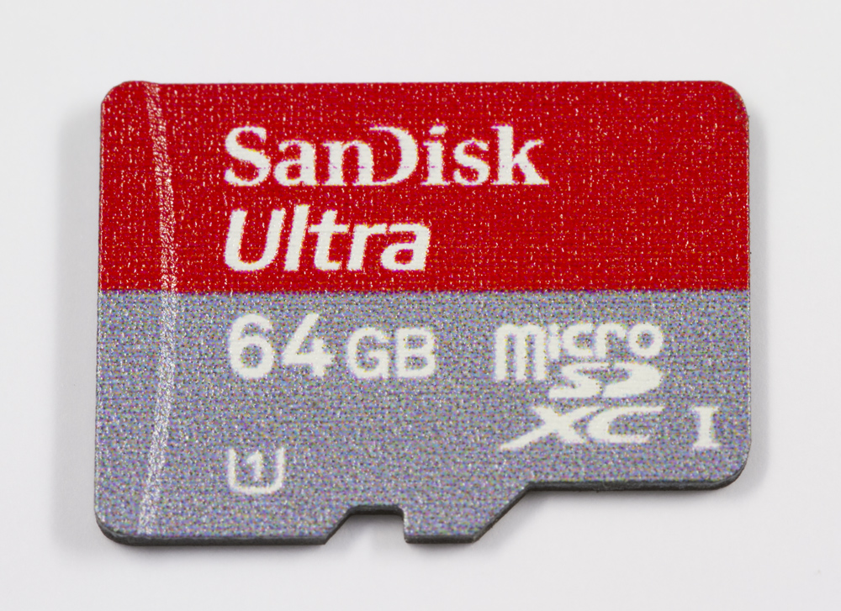
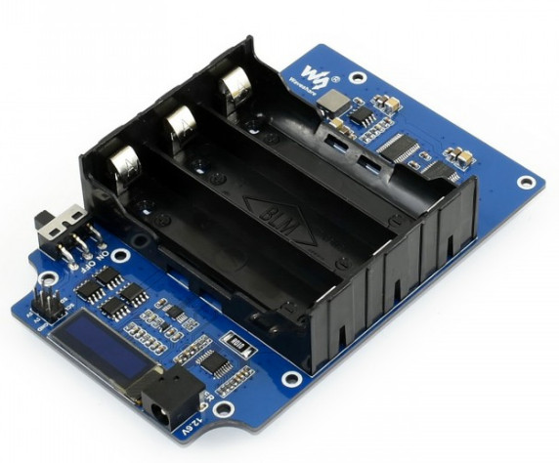


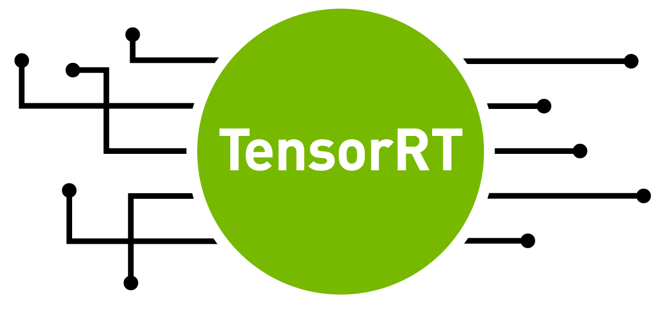
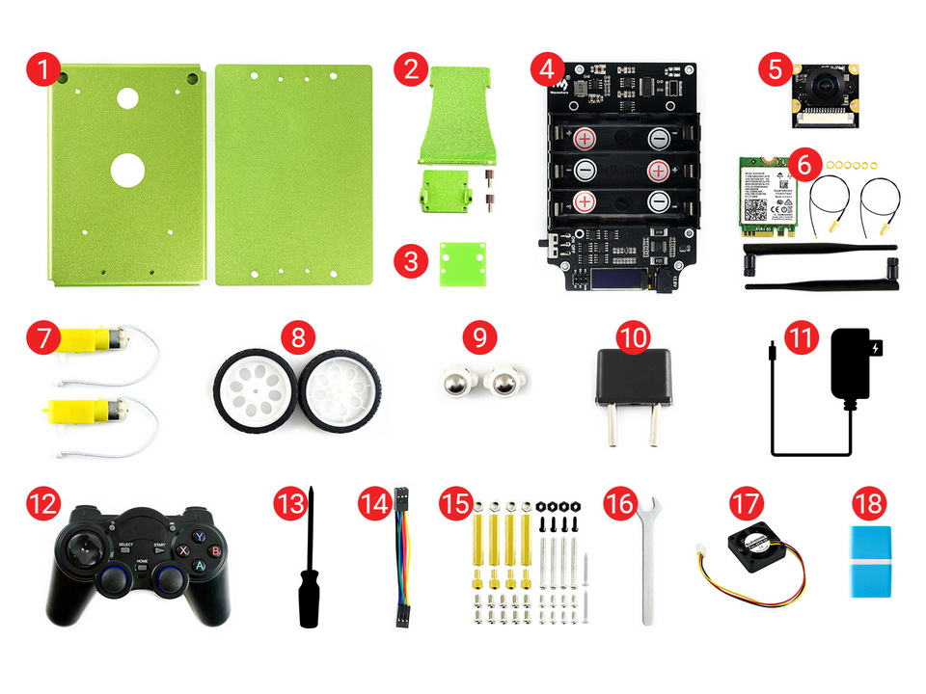




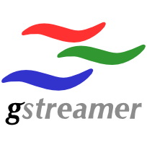
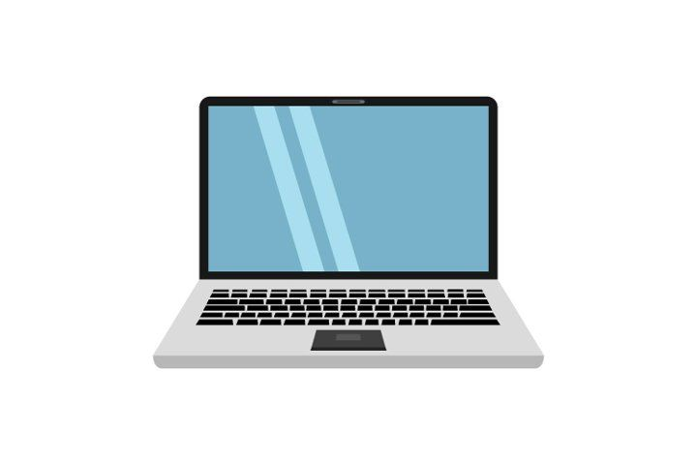
Schematic
Software
Hardware
GPU, Accessories
JetBot Car
Training
Data Collection
Camera
Gamepad
Controller
START of training process
rf-signs.py Inference code
Wheels
MicroSD Card
Motors
.onnx file
labels.txt
image-capture-single.py
WiFi Antenna
JetBot Expansion Board
Jetson Nano Card
Images
model files
Network Service
onnx_export.py
rf-signs.py Inference code
START
of inference
Annotations
train_ssd.py
Video
Streaming
Annotation Tool
Work Computer

Slide 18
Software Specification of the Project
Run a toy vehicle autonomously using a Jetson Nano GPU Card
Train an object detection neural network on images of road and signs
The robot should navigate autonomously using the object detection model
The following devices are necessary, with appropriate software on each:
work computer – ideally portable (i.e., a laptop)
JetBot with Jetson Nano GPU card
The work computer can remotely access the JetBot computer, as detailed later.
Work Computer
Uses Linux operating system (Ubuntu 20.04 LTS) in this project. However, a different operating system should also be fine. (Note: some details in these slides likely will not align with other operating systems. Adjustments would probably be necessary.)
CVAT – used to annotate data with bounding boxes
GStreamer – allows the JetBot’s camera feed to be streamed to another computer. This lets you see what the JetBot is seeing, which is very helpful.
Instructions for installing CVAT and GStreamer will be provided later in this document.

Slide 19
Software Specification of the Project
JetBot
Ubuntu 18.04 LTS – Linux operating system
Artificial Intelligence tools:
CUDA 10.2.89 – software for GPU processing
CuDNN 8.0.0.180 – GPU-based library for deep neural networks
TensorRT 7.1.3.0 – machine learning framework
PyTorch – machine learning framework
Jetson-inference (JetBot) – code for neural network deployment
These can all be set up by following the presentation linked here:
https://docs.google.com/presentation/d/1cCeMHUpsSFOgPN5odmHXncWkYEUl-6fNVQ77BbnpAJ4/edit?usp=sharing
Useful reference – jetson-inference Github: https://github.com/dusty-nv/jetson-inference
This completes the general setup of the JetBot for artificial intelligence! Now, the various models can be tried out – see the jetson-inference Github, links under Hello AI World. This project is based on the “Collecting your own Detection Datasets” guide.
More project-specific setup is still needed, as detailed on upcoming slides.
https://developer.nvidia.com/embedded/jetpack-sdk-45-archive
Information about JetPack

Slide 20
Workflow
Setup
Data Collection
Annotation
Data Organization
Running/Refining
Testing
Training
Outline:
Setup – prepare course, signs, JetBot, etc.
Data Collection – take images of the environment that the JetBot will be in, so that the JetBot can learn from those images to build a model that can interpret new images
Annotation – label and identify various objects of interest in the images by drawing bounding boxes
Data Organization – compile and prepare the data for training
Training – use the data to create an object detection model that can identify objects in new images
Testing – determine how accurate the model is
Running/Refining – Run the robot on the track autonomously using the model, making adjustments as needed
Repeat the process to train new models as necessary.

Slide 21
1. Setup
Print out and create signs as shown earlier. Place tape for a course.
Setup software – guide on Slides ¹ (if not already set up)
Note: It may be best to train on another computer, but this requires installing jetson-inference on it. Alternatively, the JetBot itself can be used to train, in which case no special action is needed.
Key points
Connecting to WiFi
Use the JetBot ports to connect it to a monitor, mouse, and keyboard. Then, login and connect to WiFi.
The JetBot’s username and password are both “jetbot” by default.
GStreamer
If not done already, install GStreamer ² on the work computer that will receive the camera feed.
Whenever you use Gstreamer, you must first open a separate terminal window on the work computer and run a command ³ to start the pipeline (gst-launch-1.0 …).
¹ https://docs.google.com/presentation/d/1cCeMHUpsSFOgPN5odmHXncWkYEUl-6fNVQ77BbnpAJ4/edit?usp=sharing
² https://gstreamer.freedesktop.org/documentation/installing/index.html?gi-language=c
³ https://github.com/dusty-nv/jetson-inference/blob/master/docs/aux-streaming.md#viewing-rtp-remotely

Slide 22
1. Setup
Remotely connecting to the JetBot
Very often, connecting a mouse, monitor, and keyboard to the JetBot is not practical, especially when the JetBot moves. Thus, we can remotely connect to the JetBot using SSH (secure shell). To do this, open a terminal window on the work computer, and type in the command ssh jetbot@<IP> to remotely access the JetBot computer.
<IP> is the IP address, which can be found on the small JetBot screen (see Slide 9) once the robot is turned on, or by running hostname -I or ifconfig in the terminal of the JetBot computer (accessible by connecting the JetBot to a monitor, mouse and keyboard).
A password prompt will appear – by default, the password is jetbot – same as before.
This will provide access to the command line on the JetBot, allowing control over the system.
Navigating the JetBot remotely requires some familiarity with the command line interface!
Some other useful commands and links to info:
Basic commands: https://ubuntu.com/tutorials/command-line-for-beginners#1-overview
VI/VIM (usage: vim FILENAME) is a text editor, allowing for creation and modification of files. Guide: https://opensource.com/article/19/3/getting-started-vim
SCP remotely copies files to and from the JetBot. Guide: https://linuxize.com/post/how-to-use-scp-command-to-securely-transfer-files/
Example: scp jetbot@<IP>:~/jetbot/src/rf-signs.py .
copies rf-signs.py from the JetBot to our current directory (dot = current directory)

Slide 23
1. Setup
The separate code for the project can be found on Github.
To follow this project, download the code and place the src folders in the jetbot directory on the JetBot. Also create a models directory inside the jetbot directory.
Note: The code in the src folder is still based on jetson-inference code, just modified. However, the rf-signs.py files’ image interpreting and robot movement were added.
In general, to run a Python file, use sudo python3 NAME.py [any command line args] with NAME.py in the current directory.
Add --flip-method=rotate-180 to the end if the program produces images with Gstreamer, as the image is flipped the wrong way by default.
Optionally, you can add --headless to the end of any program where you use flip-method, preventing the robot from attempting to stream through an HDMI port.
Examples
Use robot with gamepad controller: sudo python3 gamepad-control.py
Take images: sudo python3 image-capture-single.py --flip-method=rotate-180
Run the demo (video shown earlier):
sudo python3 rf-signs.py --flip-method=rotate-180

Slide 24
JetBot File Tree – Key Parts
(home directory of Jetson Nano card – this is how the file tree should look at this point)
jetbot/
src/ (downloaded from Github link)
data-collection/
gamepad-control.py
image-capture-single.py
detectiontest.py
rf-signs.py
models/ (created empty directory, or downloaded from Github)
(empty directory unless downloaded from Github)
(other jetbot files and directories)
jetson-inference/ (downloaded earlier in software setup process)
(directories and files for jetson-inference)
Desktop/
Documents/
…
(other directories)

Slide 25
2. Data Collection
After connecting to the JetBot with SSH, run gamepad-control.py and image-capture-single.py in two separate terminals. These are in jetbot/src/data-collection (or src-2/data-collection), you must navigate there first.
Using the gamepad controller, take images of objects of interest at various locations. Adjust code as described below. Info about image-capture-single.py is also shown on subsequent slides.
Set the correct IP address of the work computer in image-capture-single.py.
display = jetson.utils.videoOutput("rtp://[YOUR IP HERE]:1234", argv=sys.argv + is_headless)
This will broadcast camera feed to the correct work computer via gstreamer.
Most other files will require changing this as well.
Keep the “1234”!
You can check the IP address by opening a new terminal window on the work computer and typing the command hostname -I.
At the top of main in image-capture-single.py, you’ll find DATASET_PATH = ‘./[DIRECTORY]’. This directory is where the images will be saved, you may wish to change it.
Press the R1 button on the gamepad controller to take images.
Use the joysticks to quickly move the robot between images, or simply adjust by hand.
Take a couple hundred images or so, at varying angles and distances.
The greater quantity and variety of images taken, the better the model.
Images may contain multiple objects.

Slide 26
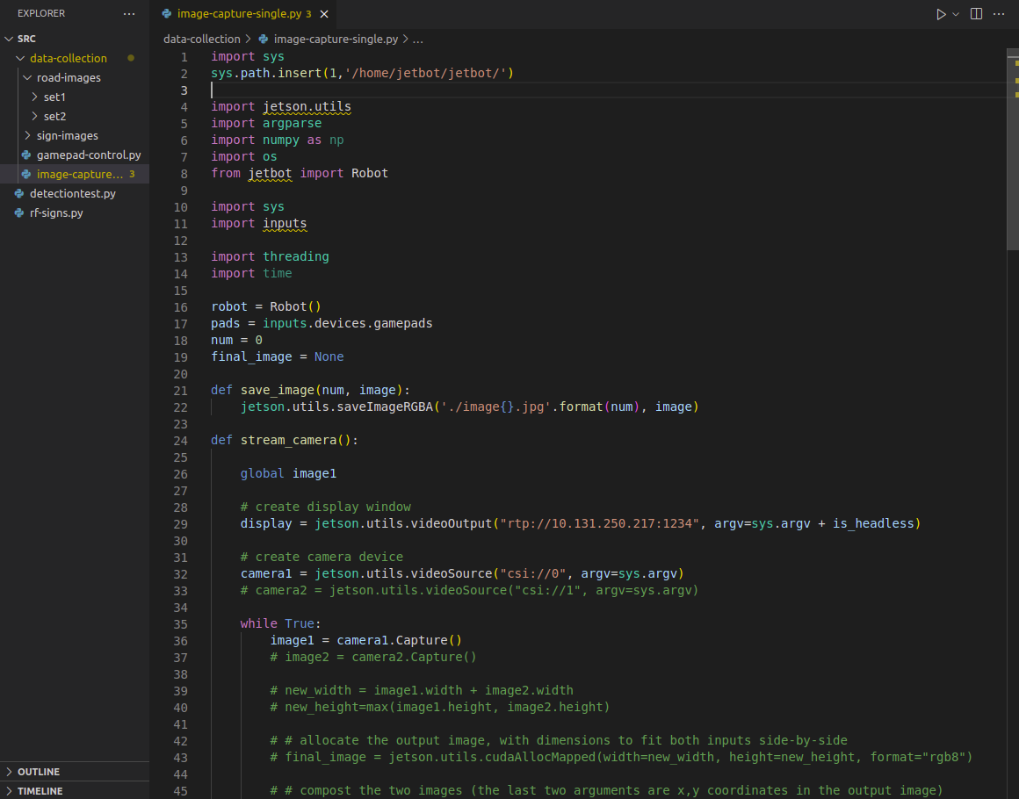
image-capture-single.py
Note: These files will generally be accessed through SSH and VIM if they are on the JetBot, not VSCode as shown. Accessing through VSCode requires SCPing to another computer.
The image name that is saved. By default: “image0.jpg”, “image1.jpg”, etc
Replace this with the IP address of the work computer (leave the :1234 the same)

Slide 27
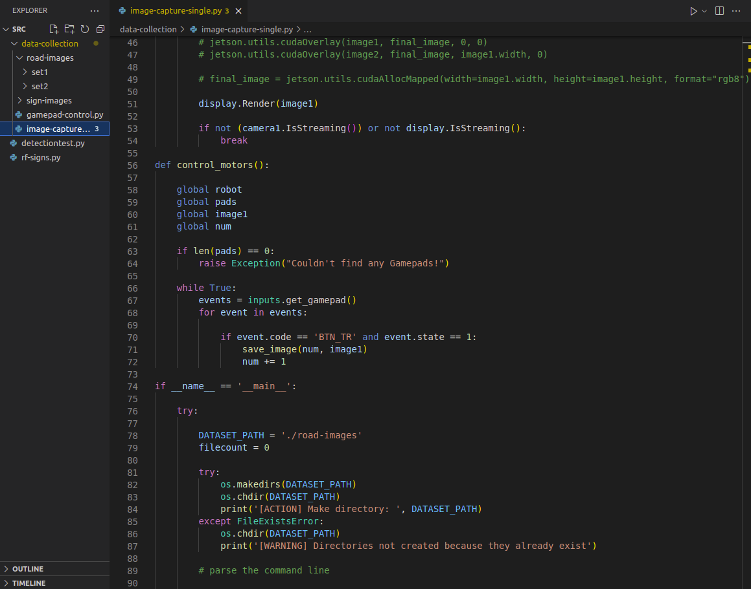
image-capture-single.py
Pressing the R1 button saves the image
Directory where images are saved to
(file continues)

Slide 28
3. Annotation
Use CVAT ¹ to draw bounding boxes around signs.
Setup: Follow the CVAT Installation Guide ² and the CVAT User Guide ³
When creating a project, set labels – the types of objects that the model should detect. For example, with signs, there is Left, Right, and U-turn.
When creating a task, upload images that were taken earlier.
Draw rectangular bounding boxes that cover the entirety of the object.
Polygonal or other annotations will not work, apparently due to incompatibility with Pascal VOC.
When finished, export the task in Pascal VOC format. There is an option to export the images themselves, but there’s no need.
More details and images of CVAT appear on subsequent slides.
¹ https://cvat.org/
² https://github.com/maheriya/cvat/blob/master/cvat/apps/documentation/installation.md
³ https://github.com/maheriya/cvat/blob/master/cvat/apps/documentation/user_guide.md

Slide 29
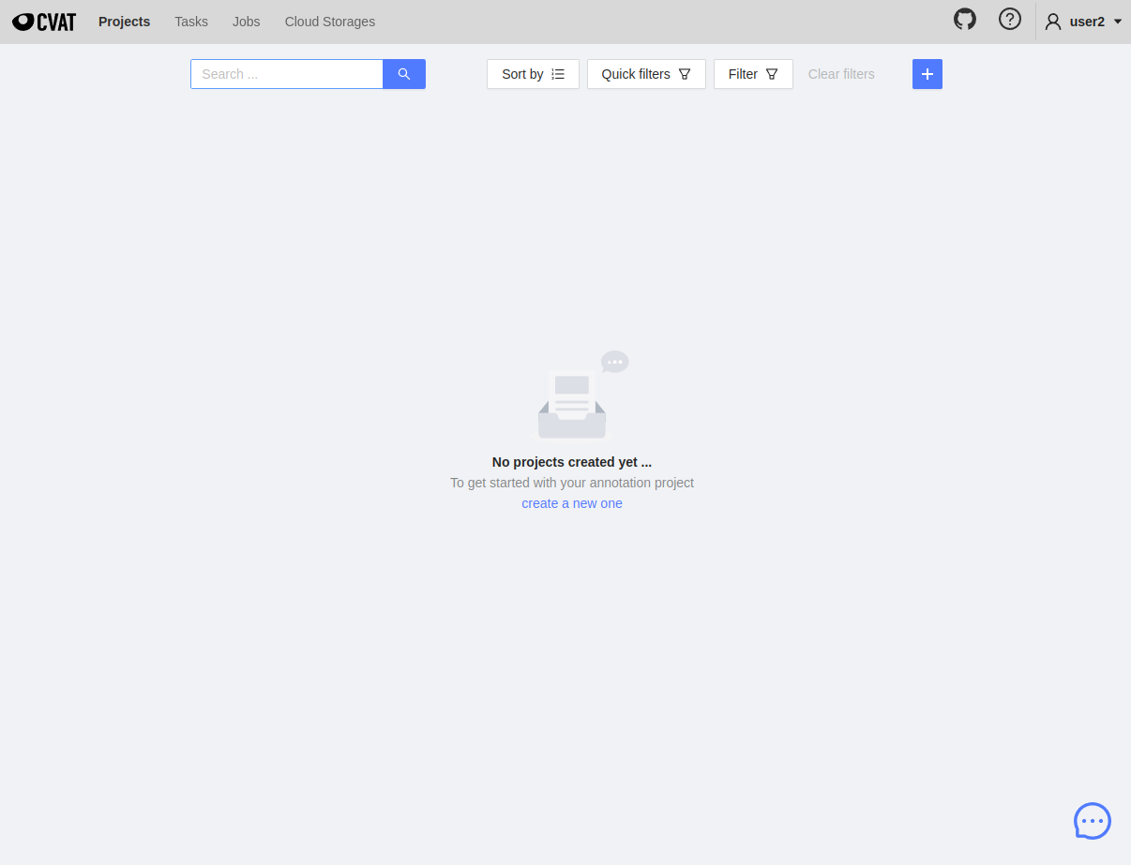
CVAT Home Page
After going to localhost:8080 and setting up an account as described in the user guide, logging in gives the following screen:
Click the + button to create a new project.

Slide 30
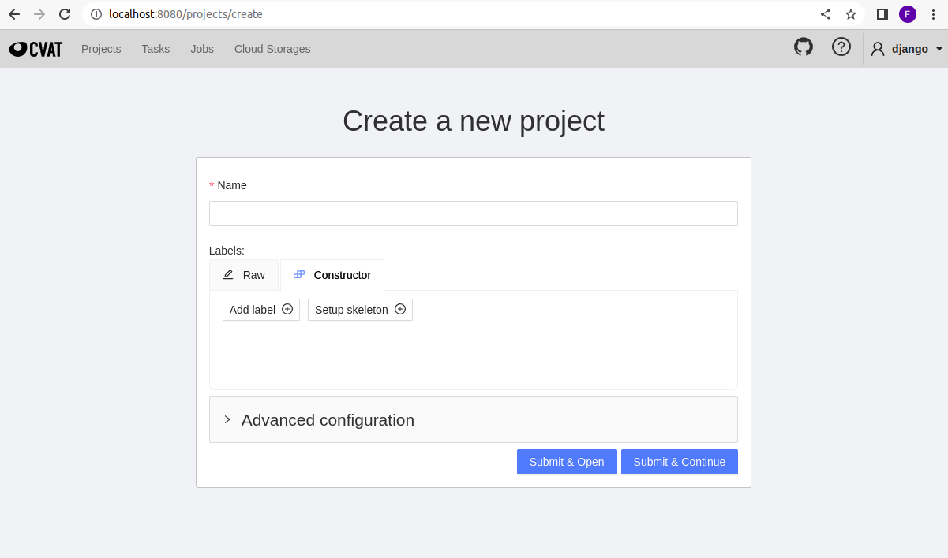
Project Creation
From the home page, press the + button to create a new project.
Use this to input labels, as many as desired.
After inputting a name and all labels, click “Submit & Open.” The names aren’t important but should be understandable.

Slide 31
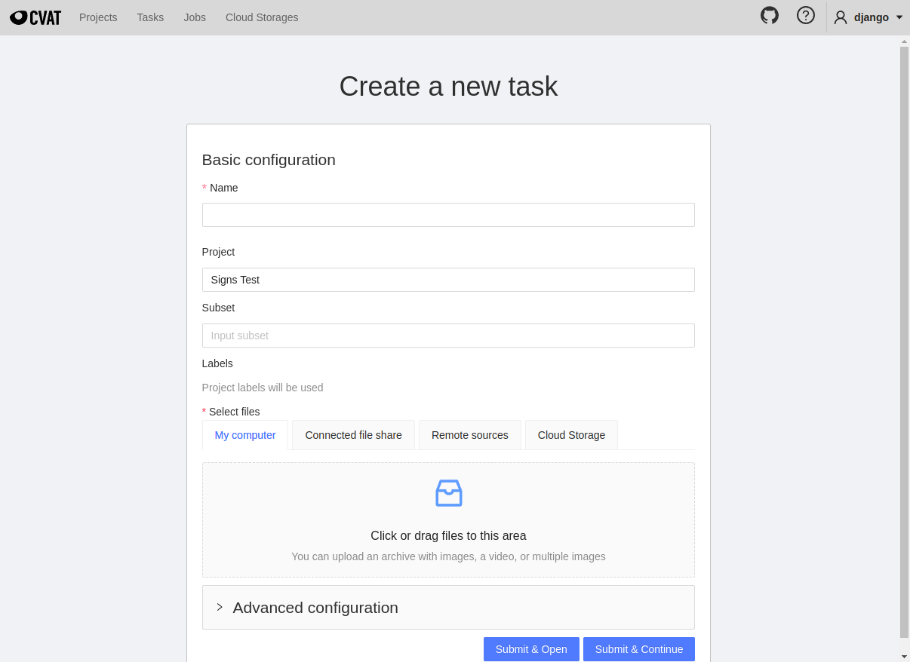
Task Creation
From the project page, press the + button and create a new task.
Upload images here.
After inputting a name and uploading, click “Submit & Open.” Then, from the task page, click on the Job that appears toward the bottom. This will open the annotation interface.

Slide 32
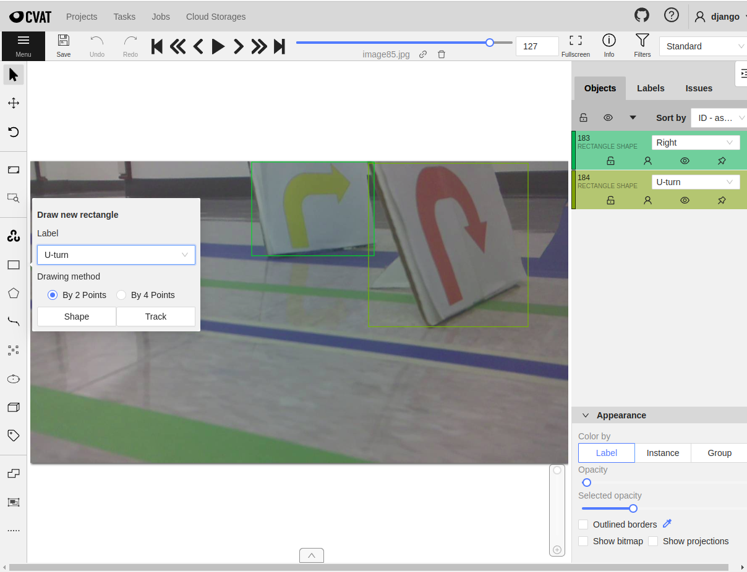
Annotating with CVAT
Be sure to save the annotations!
Use arrows to navigate between images.
Draw rectangular bounding boxes using the menu option at the left. Set the correct label, then click “Shape.”

Slide 33
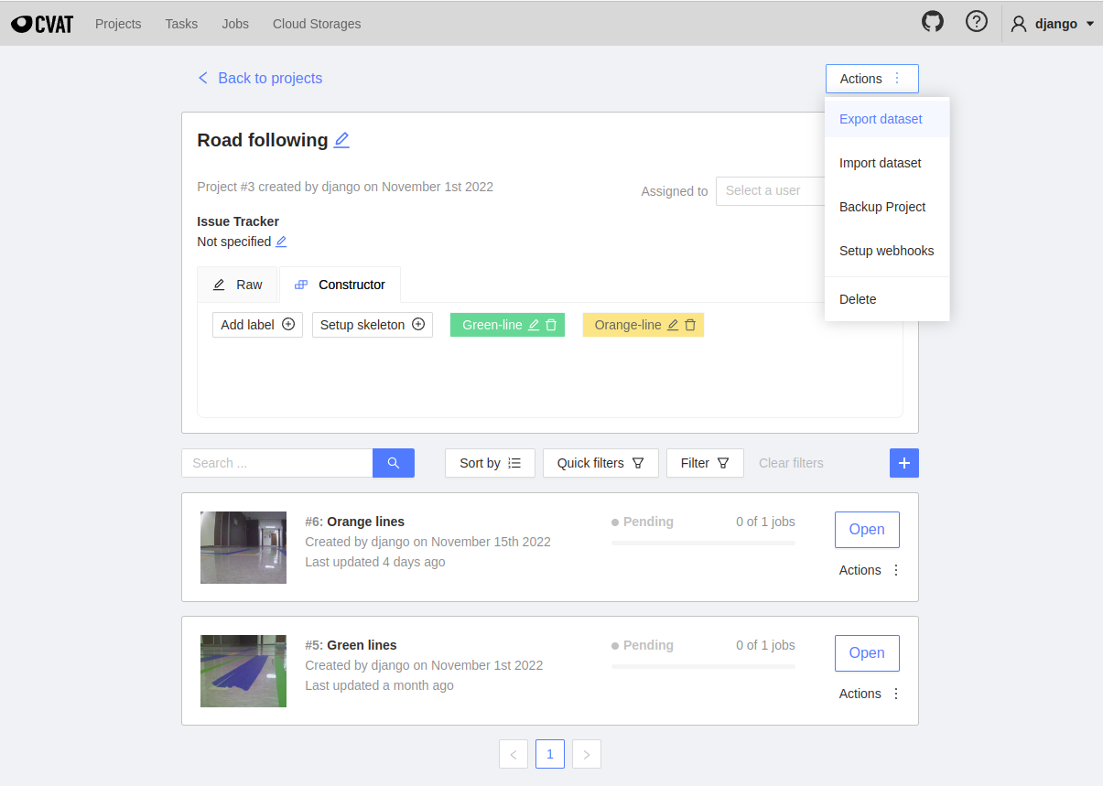
Exporting Data
Return to a project or task page.
Use this to export all the annotations within the project or task.
Use the Actions here to export all the annotations within a task or job.

Slide 34
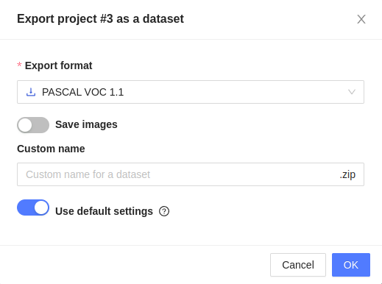
Exporting Data
When exporting, select PASCAL VOC 1.1 as the export format.
The rest can be ignored. Press “OK” to exit.
A zip file will be downloaded; extract it to a new folder. It should contain “Annotations,” “ImageSets,” and “labelmap.txt.” These contain the annotations!

Slide 35
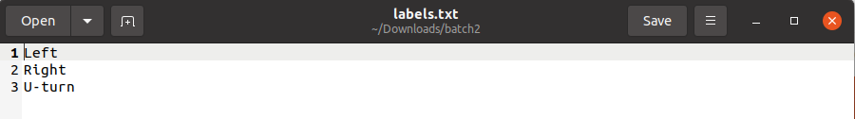
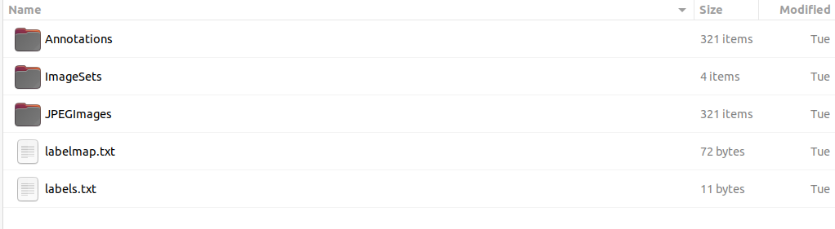
4. Data Organization
Before training, add the images to the new folder from the CVAT export.
In the directory (same as the folders called Annotations and ImageSets, add the following):
A folder called “JPEGImages” containing all the images taken
A text file called “labels.txt” containing the different labels (one line per label). For example, with signs, the file should look like this:
The directory should look something like this at the end:

Slide 36
5. Training
As outlined at https://github.com/dusty-nv/jetson-inference/blob/master/docs/pytorch-collect-detection.md#training-your-model (from the guide we are generally following for this project),
Put the folder created in the last slide into jetson-inference/python/training/detection/ssd/data.
While in the ssd folder (not data), use train_ssd.py to train an object detection model on the data collected:
python3 train_ssd.py --dataset-type=voc --data=data/<YOUR-DATASET> --model-dir=models/<YOUR-MODEL> --num-epochs=<NUM-EPOCHS>
<YOUR-DATASET> is the folder that was just put in ssd/data.
For <YOUR-MODEL>, create a folder in ssd/models to store the trained model.
<NUM-EPOCHS> is the number of training cycles.
See the next slide for a file tree before training.
Sign model was trained for 300 epochs, road following was trained for 30 epochs.
The more epochs, the better the fit, although too many epochs can lead to overfitting.
Training will take a while. When done,
Use onnx_export.py to convert the model, as described in the linked guide.
The result is an .onnx file. A new labels text file will also be created in the models folder.

Slide 37
File tree before training (on JetBot) – Key parts
jetson-inference/python/training/detection/ssd/
data/
<YOUR-DATASET>/ (arbitrary directory name)
Annotations/ (contains .xml files)
ImageSets/ (contains a directory called Main)
JPEGImages/ (contains all the images)
labelmap.txt
labels.txt (contains the labels)
(possibly other old datasets if this isn’t the first time training)
models/
<YOUR-MODEL>/ (arbitrary directory name)
(nothing here yet, empty directory)
(possibly other old models if this isn’t the first time training)
train_ssd.py
onnx_export.py
(other files, and a directory called “vision”)

Slide 38
6. Testing
To test a trained model on live camera feed:
Copy the onnx model file and the newly created labels text file to an appropriate directory, e.g., jetbot/models.
Run detectiontest.py after editing the code to refer to the appropriate model and label files. See next slide for details.
Set up the robot and environment and point the camera toward various objects of interest (the objects that were labeled earlier). Check the GStreamer feed and see if the bounding boxes are appearing as expected. (See the Improved Turning Camera View video toward the end for an idea of how it might look.)
Note: The label file is the one generated during training in the models folder. It is not the labels file made when setting up the directory before training.
Don’t forget to update the rtp IP address for viewing the camera feed through GStreamer.

Slide 39
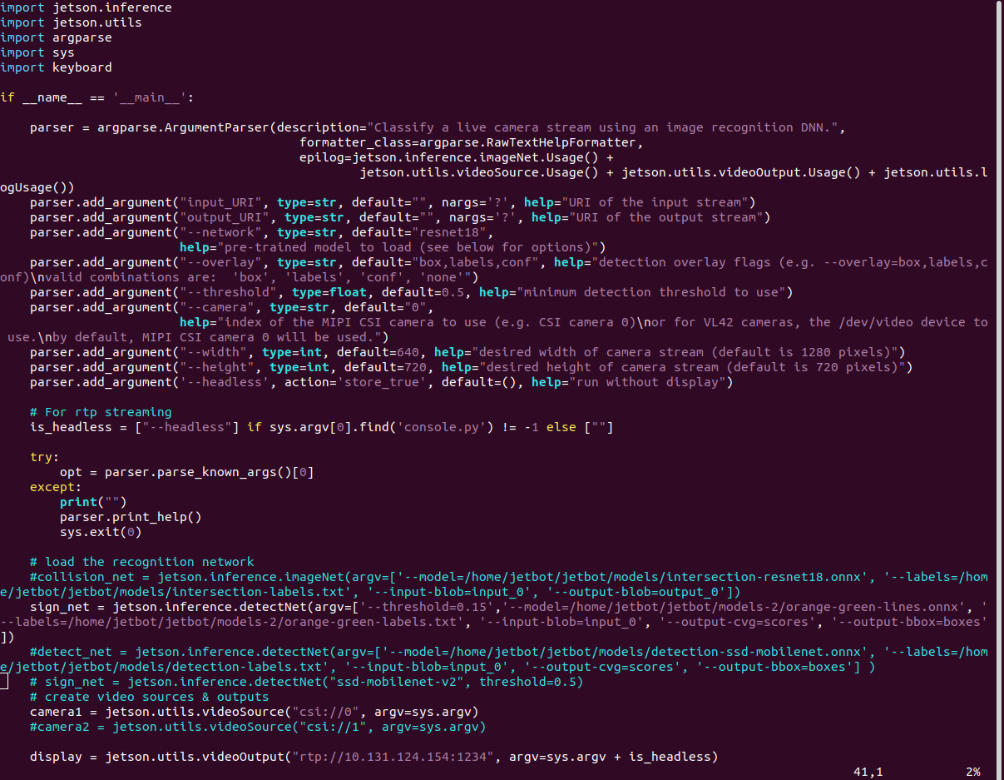
detectiontest.py
Update these to be the correct path to the model and label files
As with image-capture-single.py, change the IP address to match that of the computer that receives the camera feed through GStreamer
(file continues)

Slide 40
7. Running the robot
Use rf-signs.py to run the robot. This combines road following and turning at signs.
The same changes must be made as with detectiontest.py:
In the code, change the variables to match the model files generated in training.
Don’t forget to update the IP address (rtp) for GStreamer!
Place the robot on an end of the course, facing the intersection, and run rf-signs.py while in the src directory:
sudo python3 rf-signs.py --flip-method=rotate-180
Useful link: detectNet class
https://github.com/dusty-nv/jetson-inference/blob/master/c/detectNet.h#L109
Info about how to get the area, width, height, center, and other information about the bounding boxes
This may be useful for improving rf-signs.py.

Slide 41
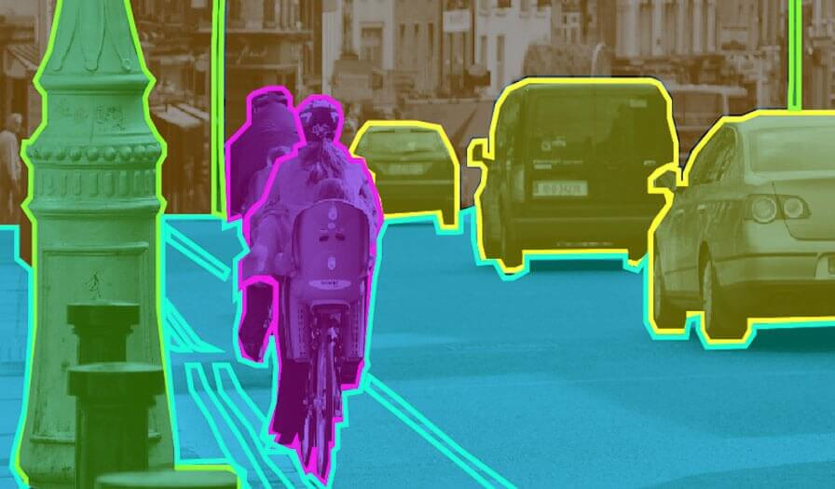
Future Possibilities
Improving the line following/turning
Detection of other robots
Segmentation

Slide 42
Updates
Improving turning
Using the same process but with more bounding boxes drawn, a new object detection model was trained to detect all green lines as well as the orange lines at the intersection.
This gives the robot the ability to turn more accurately by targeting a specific green line and dynamically adjusting to get there, rather than simply hard-coding the turn.
The resulting video, shown through the GStreamer point of view, is on the next slide.
(This is not perfect – some refinement is still needed.)

Slide 43

Object Detection Camera View

Slide 44
Collision Avoidance
By following the example from jetbot.org (https://jetbot.org/master/examples/collision_avoidance.html), we also trained the robot to navigate a room without colliding into objects. This is a classification model – the robot is either “blocked” or “free.”
The process is similar:
Collect data on JetBot
Capture various images of blocked vs free
Label and organize the data
Train neural network on the data
This uses transfer learning with ResNet-18
Optimize the model on Jetson Nano
Using TensorRT
Run live demo on JetBot
More details can be found in the link above.
A video demo is shown on the next slide. This is, again, not perfect.

Slide 45
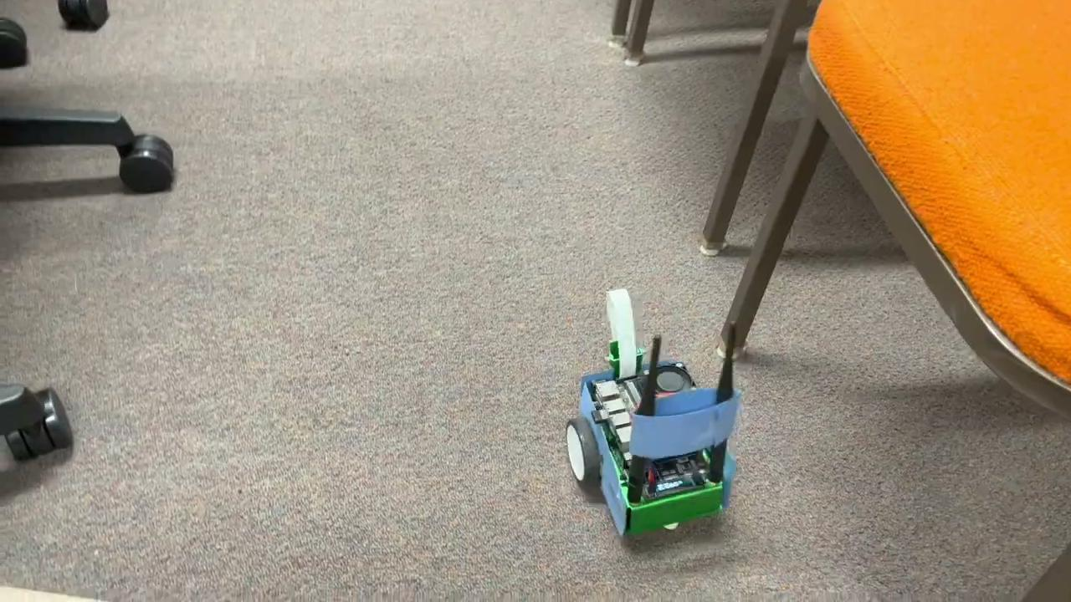
Collision Avoidance Demo

Slide 46
Some possible links of interest
https://www.nvidia.com/en-us/on-demand/session/gtcspring21-s31151/
https://www.nvidia.com/en-us/on-demand/session/gtcfall22-a41101/?playlistId=playList-5d17c33f-65f5-4fb1-9fed-bc5b7f4dec44
https://www.youtube.com/watch?v=4APkMJdiudU (7 parts)
https://www.nvidia.com/en-us/edge-computing/5g/
https://github.com/dusty-nv/jetson-inference/blob/master/docs/pytorch-collect-detection.md#training-your-model
https://gstreamer.freedesktop.org/documentation/installing/index.html?gi-language=c

Slide 47
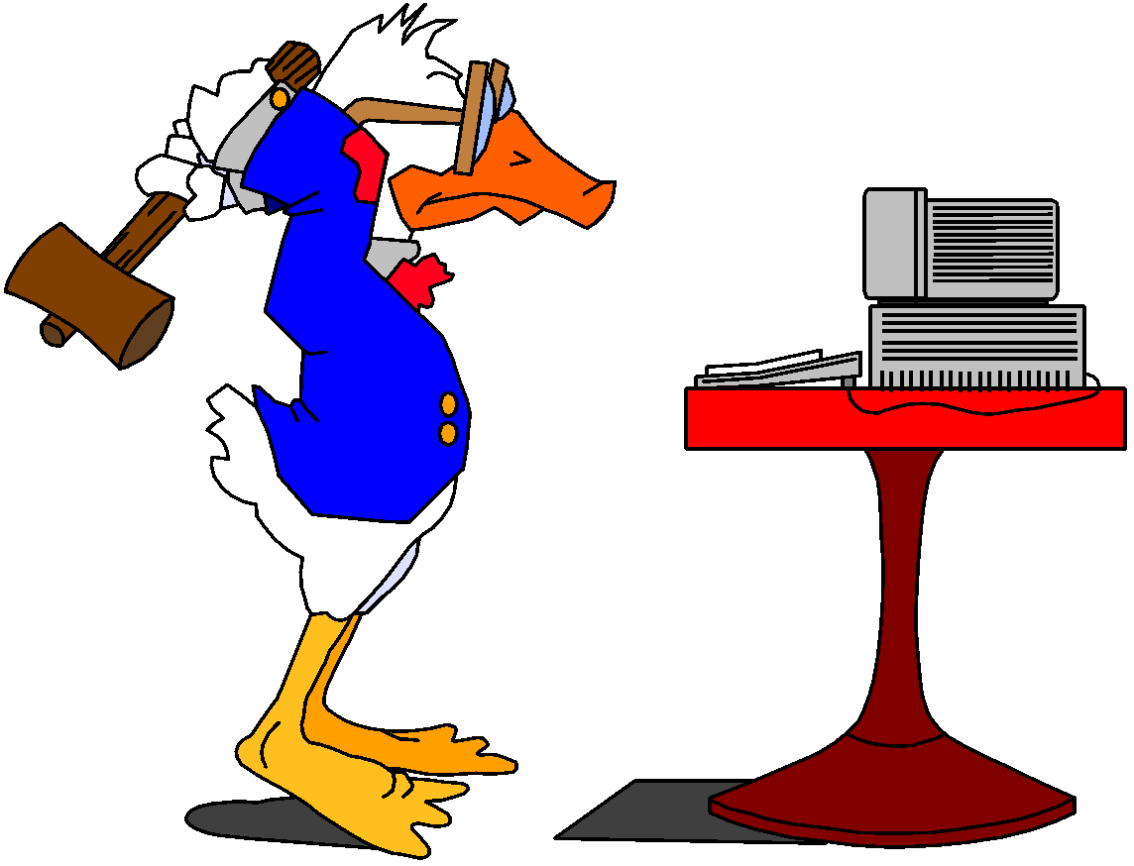

The End
The End!

